Slide 1
HYCOM (HYbrid Coordinate Ocean Model) status
Eric Chassignet¹ and Alan Wallcraft²
¹Florida State University
²Naval Research Laboratory

Slide 2
HYCOM, a numerical code
Pioneered the concept of generalized coordinates in ocean models (Bleck, 2002; Chassignet et al., 2003, 2006)
Arbitrary Lagrangian Eulerian (ALE) in the vertical
Vertical coordinate is user dependent, but default configuration is isopycnic in the interior, pressure in the mixed layer, and terrain-following in coastal areas.
http://www.hycom.org over 2000 registered users

Slide 3
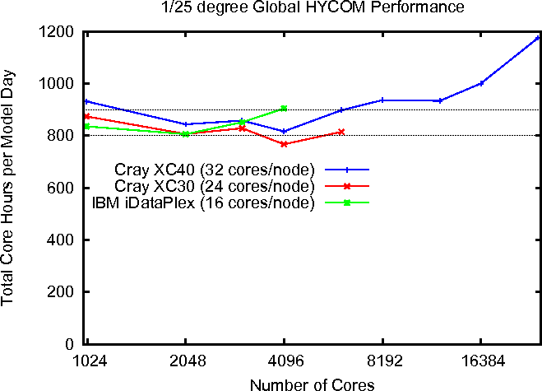
HYCOM, a numerical code
Version 2.2.98: Dynamic memory allocation and fully region independent, ESMF wrapper

Slide 4
HYCOM, the applications
Idealized configurations and process studies
Regional, basin-scale (1/50°), and global configurations (1/25°)
Impact of tidal forcing (see B. Arbic talk)
Coupled to Los Alamos CICE sea ice and to the CAM atmospheric model in CESM and to NAVGEM atmospheric model in Navy ESPC

Slide 5
Operational HYCOM
Operational at NAVOCEANO since 2008
GOFS 3.1: 1/12° 41 layer HYCOM/NCODA-3DVAR/ISOP synthetics/CICE
Add nine near surface layers
Two-way coupled HYCOM with Los Alamos CICE model
Replace MODAS synthetics with Improved Synthetic Ocean Profiles
Validation test report completed – scheduled to be operational by the end of 2016
GOFS 3.5: 1/25° 41 layer HYCOM/NCODA-3DVAR/ISOP synthetics/CICE/tides
Increase equatorial horizontal resolution to ~3.5 km
Tidal forcing
Scheduled to be operational early in 2018

Slide 6
Operational HYCOM
Also in use operationally by NOAA-NCEP, SHOM (France), TOPAZ (Norway), REMO (Brazil), and INCOIS (India)
Navy 1/12° forecasts and 1993-2014 reanalysis are served on the FSU COAPS server (www.hycom.org/data)
Accessed more than 250 million times a year
Consumes more than 1000 TB (1 PB) of outbound bandwidth annually

Slide 7
Going forward – NEXT-GEN HYCOM
Open development platform => GitHub
Needs to be collaborative (multi-group and multi-national) around a common code base => Coordinated funding?
4th order in space, two-level time stepping
CVMix, ePBL
Wetting and drying
Parallel NetCDF (serial is too slow)
Non hydrostatic
Etc.

Slide 8
Thoughts
Community-based model environment
It is harder and harder for a small group of developers to keep a single community ocean model up to date and may require a rewrite from scratch (i.e., MPAS-O, MOM6)
CVMix is a step in the right direction, but one could look into doing the same for dynamical cores, advection routines, etc.
Should allow for the biogeochemical component to interact seamlessly with the dynamical core
Interchangeable algorithms => ensemble runs and more error estimate

Slide 9
Thoughts
Rectangular or alternative grid?
Not a demonstrated advantage of alternative grid
Preference would be to efficient embedded parallel two-way nesting
Need to adapt to new architectures such as GPUs and MICs

