Slide 1
Predictability of Dry Season Reforecasts Over the Tropical South American Region
Masters Thesis Defense Dry Run 16 February, 2011
Adam Frumkin

Slide 2
Outline
Objectives
Introduction
Data
Methodology and Results
Summary and Conclusions

Slide 3
1 Objectives
Locate regions of model bias for two-meter air temperature and daily precipitation rate.
Does downscaling from a global climate model improve predictability of precipitation or temperature?
How does the model depict land-atmosphere interactions in South America?
Notes:
2. Additionally, how does anomaly nesting affect the predictability of events

Slide 4
2 Introduction: Outline
Motivation
Background
The South American monsoon climate.

Slide 5
2.2 Motivation
The SAM is part of the American Monsoon System (includes the SAM and NAM).
Evapotranspiration at the end of the dry season may play a role in initiating convection during the wet season (Myneni et al. 2007).
Preliminary research shows dry season precipitation is highly correlated with wet season precipitation which is also highly correlated with the Atlantic Warm Pool.
Notes:
Being able to predict the onset or demise of either part of the system improves predictability of the other part.

Slide 6
2.1 Background: Climate
South America has only recently been recognized as having a monsoon.
Zhou and Lau (1998) were the first scholars to identify the South American Monsoon (SAM).
There is still debate as to whether or not the SAM meets the classic (i.e., East Asian Monsoon) definition of the word (Zhou and Lau, 1998).

Slide 7
2.1 Background: Climate
Characteristics of a monsoon climate include:
Shift in overturning circulations
Seasonal change in precipitation rate
Seasonal reversal of wind direction
The South American Monsoon exhibits all but #3.

Slide 8
2.1 Background: Climate
R. Wang, The Asian Monsoon (2006)

Slide 9
2.1 Background: Climate
Vera et al. (2006)

Slide 10
2.1 Background: Climate
Monsoon Low Level Winds
South American Monsoon
There is a seasonal reversal of wind direction associated with the East Asian Monsoon.
Due to persistent tropical easterlies there is no seasonal reversal in wind direction within the monsoon region of South America.
A reversal in direction can be observed when the annual mean is removed.
Zhou and Lau (1998)

Slide 11
2.1 Background: Climate
The monsoon circulation is driven by enhanced heating in the Andes Mountains.
Onset occurs in mid-late October for a majority of the region.
Onset features:
Eastward displacement of the subtropical high
Strong thermal gradient between Atlantic Ocean and the continent
SLP decreases and Chaco Low deepens
Increase in moisture transportto the monsoon region through the South American Low Level Jet
Zhou and Lau (1998), Vera et al. (2006)

Slide 12
2.1 Background: Climate
Features of the demise of the South American Monsoon:
Precipitation minima during JJA
SLP increases over the continent
Easterlies weaken but do not reverse direction
Zhou and Lau (1998), Vera et al. (2006)

Slide 13
3 Data: Outline
Models
Reanalysis
NCEP Climate Forecast System (CFS)
NCEP Scripps Regional Spectral Model (RSM)
RSM with Anomaly Nesting (RSM-AN)
Climate Forecast System Reanalysis (CFSR)
CPC Merged Analysis of Precipitation (CMAP)
Tropical Rainfall Measuring Mission (TRMM)
Climate Research Unit (CRU) Near Surface Temperature

Slide 14
3.1 Models: Output
Models are integrated from 2001-2007 beginning 00Z May 23rd.
We are only concerned with June-July-August which corresponds to the dry season.
Data is available in a six hourly format for the CFS and for both RSM integrations.

Slide 15
3.1 Models: CFS
Fully coupled land-ocean-atmosphere global climate model
64 vertical levels
Run at triangular spectral truncation of T62
Six ensemble members are generated by resetting the date of the atmospheric restart file after one week of integration.
The CFS was the first model in the US to achieve a level of skill comparable to statistical models.

Slide 16
3.1 Models: RSM
28 vertical sigma levels
60km horizontal resolution
We dynamically downscale from the CFS using the RSM.
The domain covers most of North America and South America.
This was done so that the wet season of the NAM and it’s dry season counterpart in the SAM could be studied.

Slide 17
3.1 Models: Anomaly Nesting
Bias correction tries to remove the global model’s bias before the downscaling process is performed.
This is done by replacing the GCM’s climatology with reanalysis climatology (Misra and Kanamitsu 2004).
The RCM can have no advantage over the GCM because it retains the systematic errors of the GCM through the downscaling process (Pan et al. 2001).
In this study we replace the CFS climatology with NCEP-NCAR reanalysis 1 (atmosphere) and ERSSTv2 (SSTs)

Slide 18
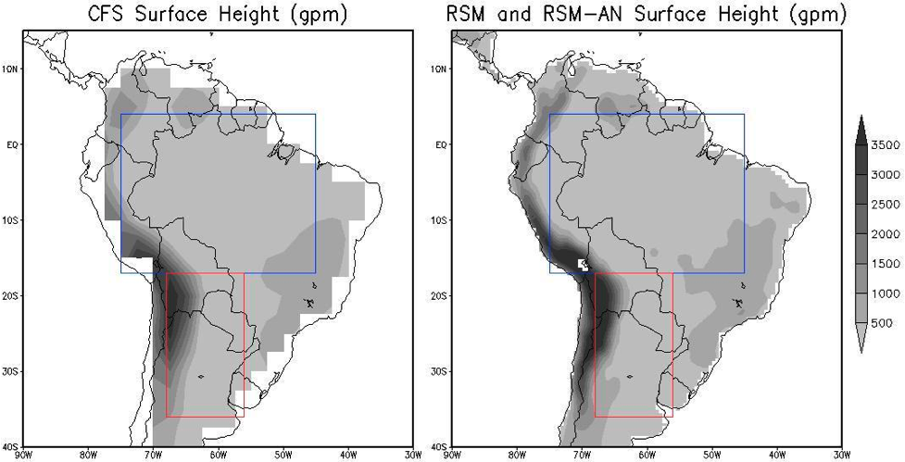
3.1 Models: Domain
Notes:
We can clearly see that the RSM does a better job depicting coastlines. This is one of the benefits of downscaling.
ARB=4°N and 17°S and between 45°W and 75°W
ST =17°S and 36°S and between 56°W and 68°W

Slide 19
3.2 Reanalysis
Reanalysis | Variables | Resolution
CFSR (Saha et al. 2010) | Temperature, Precipitation, Evaporation, Downwelling Shortwave Flux | 0.5°x 0.5°
CMAP (Xie and Arkin, 1997) | Precipitation | 2.5° x 2.5°
TRMM (Merged Analysis) | Precipitation | 0.25° x 0.25°
CRU (Mitchell and Jones, 2005) | Temperature | 0.5 x 0.5

Slide 20
4 Methods and Results
1
Model Bias
Potential Predictability
Calculation of the area under the ROC curves (AUC)
Land-Atmosphere Feedbacks
2
3
Notes:
I will not explain the methods further right here because I don’t want people to forget my explanation of them.

Slide 21
4.1 Model Bias
We can locate regions of bias by calculating the statistically significant differences between the models and CFSR.
Averaging is done for JJA, 2001 through 2007.
Difference plots are created for two-meter air temperature and for precipitation.

Slide 22
4.1 Model Bias
All three models display distinct ITCZs and maxima over elevated terrain.
CFS is the driest
RSM is the wettest.

Slide 23
4.1 Model Bias
RSM is positively biased over the ARB and ST.
RSM-AN and CFS are negatively biased over both regions.

Slide 24
4.1 Model Bias
CFS is positively biased over the ARB and negatively biased over the ST.
RSM and RSM-AN are positively biased over both regions.
The magnitudes of their biases are much smaller than those of the CFS.

Slide 25
4.1 Summary
Precipitation biases were lowest in the RSM-AN for both regions and highest in CFS for both regions.
Temperature biases were lowest in the RSM for both regions.
The CFS had the largest temperature bias in the ARB.
The RSM-AN had the largest in the ST.

Slide 26
4.2 Potential Predictability
We calculate the ratio of the external variance (signal) to the total variance following Kumar and Hoerling (1995). We do this for precipitation and temperature.
Total variance is the sum of external variance and internal variance.
External variance - slowly varying boundary conditions (SSTs)
Internal Variance – noise/uncertain initial conditions
Values Near 1 mean that the boundary conditions are overwhelming the effect of noise. Values near zero mean that the model is not “seeing” the boundary conditions and predictability will be hindered (Stefanova et al. 2010).
Notes:
Variance of the External type is easier to predict so larger ratios mean more predictability. Smaller ratios mean that more of the variance is due to the difficult-to-predict initial conditions or internal variance.

Slide 27
4.2 Potential Predictability
There are very few regions where the ratio is >0.5.
CFS has the highest potential predictability in the ARB.
RSM has the highest potential predictability in the ST.

Slide 28
4.2 Potential Predictability
Potential predictability is much higher in the ARB than the ST.
RSM-AN has the highest potential predictability in both regions.

Slide 29
4.2 Summary
Precipitation
CFS should have the most skill in the ARB✖
RSM should have the most skill in the ST✔
Temperature
RSM-AN should have the most skill in both regions✔
The models should have more skill predicting temperature than precipitation.✖
Except the CFS (ARB Precip > ARB Temp)✔
The models should have more skill in the ARB than in the ST.✔

Slide 30
4.3 Relative Operating Characteristic (ROC) Curves
We calculate ROC curves from contingency tables following Mason and Graham (1999).
The ROC curve can be used to calculate the skill of our forecast system.
The calculation of the area under the curve is the simplest method of displaying the result of the ROC curve.

Slide 31
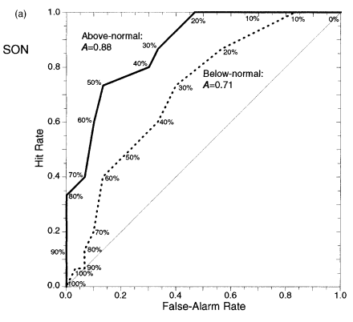
4.3 ROC Curves
We are conducting ensemble forecasting so each contingency table represents a different threshold.
A threshold is the number of ensemble members required to correctly forecast an event.
Table Modified From Mason and Graham (1999)

Slide 32
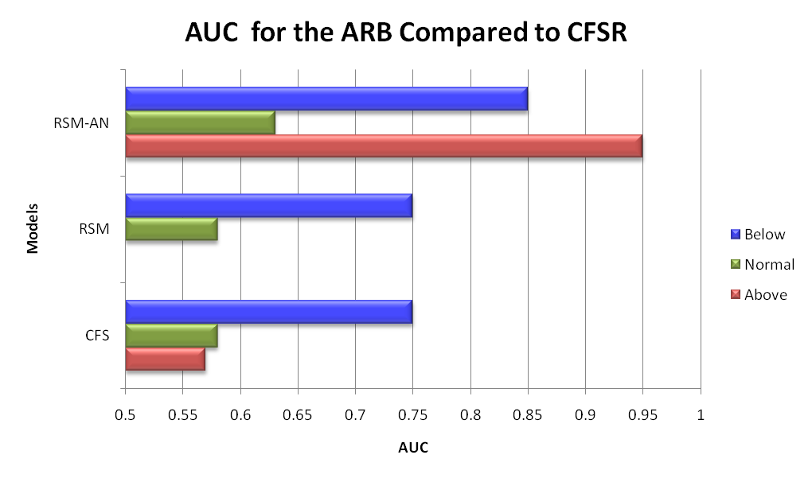
4.3 ROC: Precipitation
The RSM-AN displays the most skill for all possible events.
The CFS has slightly more skill than the RSM.
Notes:
Remember to explain the figure before explaining the results of the figure.

Slide 33
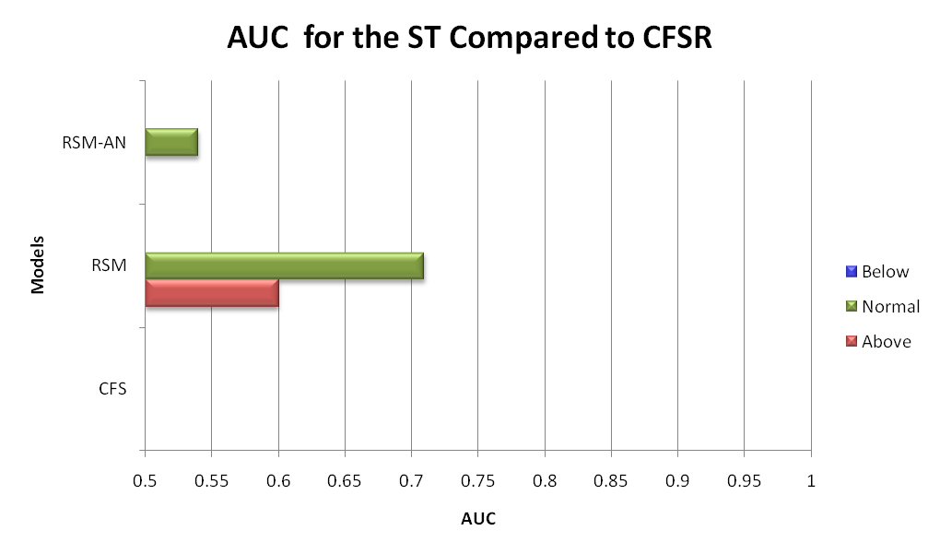
4.3 ROC: Precipitation
The RSM has the most skill for all events.
Generally less skill is observed in the ST than in the ARB. The exception to this is the RSM.

Slide 34
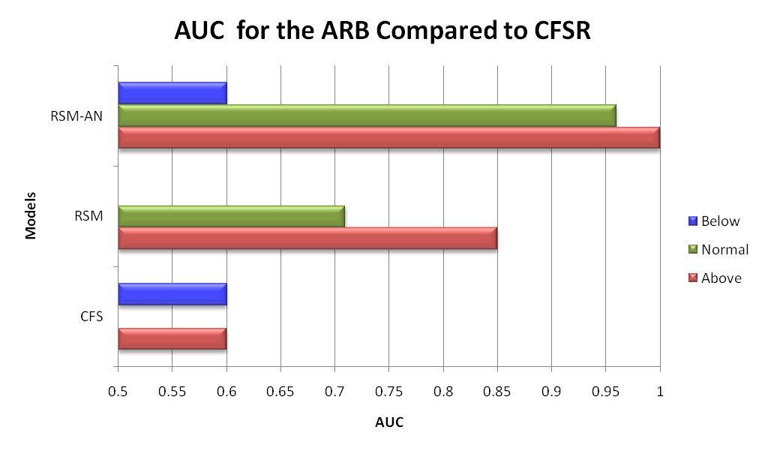
4.3 ROC: Temperature
The RSM-AN displays the most skill again.

Slide 35
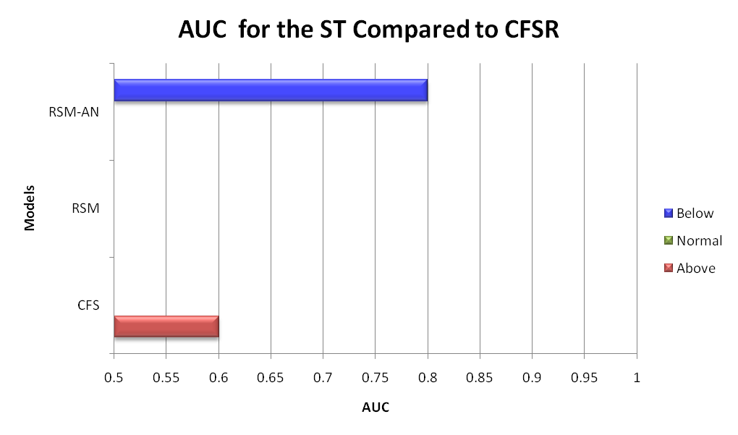
4.3 ROC: Temperature
There is much less skill observed in the ST than in the ARB.
One could argue that the RSM-AN has the most skill because it forecasts one event better than the CFS.

Slide 36
4.3 Summary
AUCs confirm that potential predictability was a good first approximation of model skill.
There is generally more skill in the ARB than in the ST (a few exceptions).
Temperature is predicted more skillfully than precipitation in the ARB, except for below normal events.
CFS has more skill predicting precip. in the ARB than temperature

Slide 37
4.4 Land-Atmosphere Interactions
Koster et al. (2003) splits the land-atmosphere feedbacks into three parts:
wetting of soil by precipitation
enhancement of evaporation by the wet soil
enhancement of precipitation by evaporation
The first point obviously happens in nature.

Slide 38
4.4 Land-Atmosphere Interactions
We can explain the last two parts through contemporaneous correlations.
Part two can be shown to occur through correlations of temperature and precipitation.
Part three can be shown by correlating downwelling shortwave flux with evaporation and precipitation with evaporation.

Slide 39
4.4 Land-Atmosphere Interactions
Variable Pairing | Positive | Negative
Temp. w/ Precip. | Evaporation is not necessarily leading to precipitation (Koster et al. 2003). | Precipitation ➔Evaporation ➔Evaporative Cooling ➔More Precipitation (Koster et al. 2003)
DSWFw/ Evap | Evaporation is energy limited (Misra and Dirmeyer, 2009). | Evaporation is moisture limited (Misra and Dirmeyer, 2009).
Evapw/ Precip | Indicates a non-arid regime where local evaporation leads to precipitation (Misra and Dirmeyer, 2009). | This is the mark of an arid regime where there is abundant evap. but little precip. (Misra and Dirmeyer, 2009).

Slide 40
4.4 Land-Atmosphere Interactions: CFS
Evaporation is leading to precipitation | Energy limited | Energy Limited
Notes:
evaporation is leading to precipitation and acting to cool the near surface air.
This is less obvious in the ST and southern portions of the ARB
In the middle plot, all positive correlations indicate that evaporation is energy limited
Mostly negative correlations indicate that precipitation is also energy limited.
In other words there is not enough evaporation to support precipitation

Slide 41
4.4 Land-Atmosphere Interactions: RSM
Evaporation is leading to precipitation | Energy limited | Energy Limited

Slide 42
4.4 Land-Atmosphere Interactions: RSM-AN
Evaporation is leading to precipitation | Energy limited | Energy Limited

Slide 43
4.4 Land-Atmosphere Interactions: CFSR
Evaporation is leading to precipitation | Energy limited | Moisture Limited

Slide 44
4.4 Land-Atmosphere Interactions
The models suggest that local evaporation is less important than does CFSR.
Evidenced by conflicting results between boxes 1 and 3
The models suggest that evaporation and precipitation are energy limited.
CFSR suggests that evaporation and precipitation are energy limited and moisture limited respectively.

Slide 45
6 Conclusions
We cannot use bias as a first approximation of model skill. Regions of lower bias do not necessarily mean more skill.
Potential predictability scores can be used as a first approximation. In the ARB, downscaling improves upon the skill of the CFS and anomaly nesting improves upon the skill of the downscaling.
In the nosier subtropical region, the benefits from downscaling and anomaly nesting are less pronounced.
The models depict South America as an arid climate where local evaporation is less (compared to CFSR) important to rainfall.

Slide 46
Limitations and Future Work
We only have a small subset of seven years and we only have six ensemble members.
ROC curves are very sensitive to the differences in separate observational data sets.
In order to determine exactly how precipitation and evaporation interact within the models a full moisture budget would need to be conducted.

Slide 47
2.1 Background: Climate
Monsoon Features
Conceptual Diagram
LL Cross Equatorial Flow
Northwesterlies
Chaco Low
Subtropical High
SACZ
Mid-latitude Westerlies
Bolivian High
UL Return Flow
Zhou and Lau (1998)

Slide 48
4.3 Receiver Operator Characteristic Curves
Individually choose a value below which is considered below normal and a second value above which is considered above normal. Do this individually for the model ranking and obs ranking
Using the obs rankings of the years determine how well the model matches this by creating a set of contingency tables.
Each contingency table represents a different threshold.

Slide 55
Extra Figures

Slide 67
Precipitation
RSM | ARB | 0.284957
RSM | ST | 0.221454
AN | ARB | 0.238857
AN | ST | 0.201998
CFS | ARB | 0.295158
CFS | ST | 0.125914
Temperature
RSM | ARB | 0.423523
RSM | ST | 0.241186
AN | ARB | 0.52827
AN | ST | 0.287035
CFS | ARB | 0.281875
CFS | ST | 0.23095

Slide 68
ARB Precip | RSM | AN | CFS
CFSR | 0.873358262 | -0.749822976 | -1.133152629
CMAP | -1.688243167 | -3.311424405 | -3.694754057
TRMM | -0.573443167 | -2.196624405 | -2.579954057
ST Precip | RSM | AN | CFS
CFSR | 0.214093167 | -0.097624095 | -0.426929619
CMAP | -0.347700262 | -0.659417524 | -0.988723048
TRMM | 0.363488452 | 0.05177119 | -0.277534333
ARB Temps | RSM | AN | CFS
CFSR | 0.010361905 | 0.911411429 | 3.450090476
ST Temps | RSM | AN | CFS
CFSR | 0.566916667 | 2.10339619 | -1.447493333

