Slide 1
WINDS AND CURRENTS MISSION
Mark A. Bourassa and Qi Shi
With much of the modeled coupling shown here from Qi Shi
And a great deal of input from the Winds and Currents team:
Ernesto Rodriguez, Dudley Chelton, Dmitry Dukhovskoy,
Tom Farrar, M. Mar Flexas, Brian Haus, David Long, Rick Lumpkin, Thomas Kilpatrick, Nikolai Maxeminko, Dimitris Menemenlis, Steven L. Morey, Alexis Mouche, Dragana Perkovich,
Roger Samelson, Bryan Styles, Andrew Thompson,
Frank Wentz, and Shang-Ping Xie
& the rest of the WaCM team

Slide 2
Wind and Current Mission Concept Goals
The Winds and Currents Mission is a concept that has gone through a lot of testing and development
  We know it is feasible
The goals:
  To make the first every measurements of ocean vector currents from space (two vector components at the same time)
  Simultaneously observe coincident ocean surface vector winds and currents (currents and winds at the same time and location)
  Measure with sufficient sampling density and accuracy to address a wide range of science questions and applications
The approach:
  A Ka-band Doppler Scatterometer
    High resolution, very wide swath

Slide 3
Motivations
Air/sea coupling (forcing and response) has physics that should be parameterized with time averaged motions relative to the surface current
We don’t measure a true surface current
  Drifting buoys are drogued at a depth of 15m
  ARGO does not measure within 5m of the surface, and sampling is far too sparse
  Altimetry provides a geostrophic current, but that appears to be substantially different from a surface current for many applications
  Coastal radar might work near the coast
Models of the near surface current are hugely different in their vertical profiles of current
  Knowing the surface current will help figure out the physics

Slide 4
Research Objectives for Model-Based Test
Develop a novel two-way coupled modeling system that includes ocean current and wind stress coupling based on the Coupled-Ocean-Atmosphere-Wave-Sediment Transport Modeling System (COAWST)
Examine the impact of ocean currents and waves on ocean and atmospheric simulations
Explore the feedback mechanisms and dominant physical processes in coupling wind stress to ocean currents and waves

Slide 5
Coupling Among Three Modeling Components
Wind stress, Surface heat fluxes
Radiation, Precipitation,
Sea level pressure
Ocean
(ROMS)
Atmosphere
(WRF)
Sea surface temperature
Surface currents
Surface currents
Wave length, height, period and direction
+
Modified MYNN
Wave
(SWAN)
10-meter wind wrt Surface Current
Wave height and wave length
Atmospheric, ocean and wave models are synchronized every 10 minutes to exchange data fields through the Model Coupling Toolkit (MCT).

Slide 6
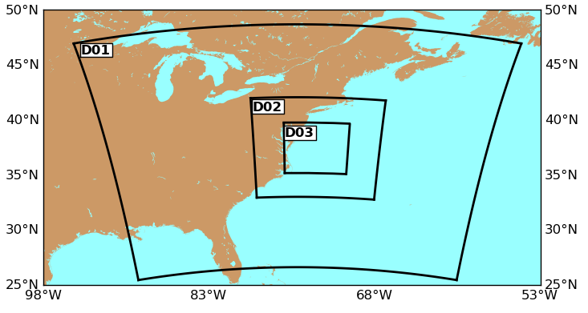
Experimental Details
Model resolution
- Horizontal Resolution: 30 km, 10 km, 3.3 km
- Vertical Resolution: 30 layers for WRF,
16 layers for ROMS
Physical options for WRF
- COARE 3.0 bulk flux algorithm
- PBL Scheme: MYNN
Simulation time: One month (Oct 1 - Oct 31, 2012)

Slide 7
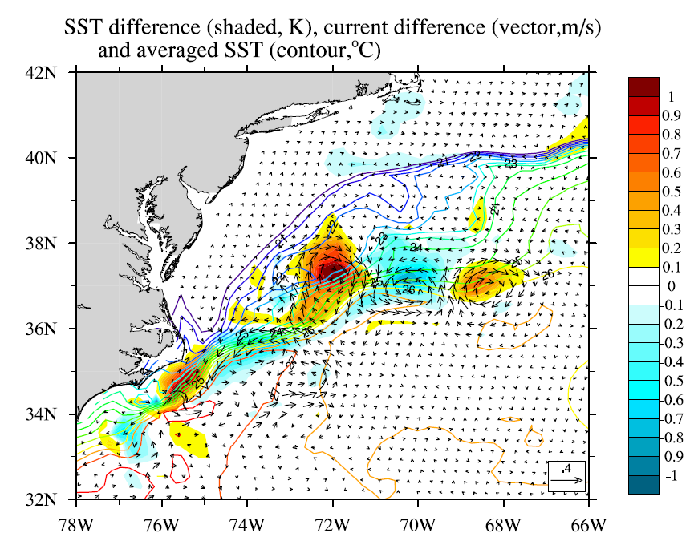
Coupling ocean currents and wind stress significantly changes SST
(CUR- CTL)
(ºC)
Big SST changes and surface currents changes are collocated near ocean front
SST and surface currents changes show similar warm/cold core ring features as previous satellite observation studies
SST change (color shaded, ºC)
Surface current change (vector, m/s)
Mean SST (color contour, ºC)
Notes:
Shading: monthly-averaged temperature change
Contour: monthly-averaged temperature
Vector: monthly-averaged current change
Cape Hatteras (35.2 N 75.5w) Grand banks (40.7 B 74W) Gulf stream proper

Slide 8
Surface wind responses to SST change
(CUR- CTL)
ºC
Monthly-averaged SST difference (color shaded, ºC)
Monthly-averaged 10-meter wind speed difference (contour, m/s)

Slide 9
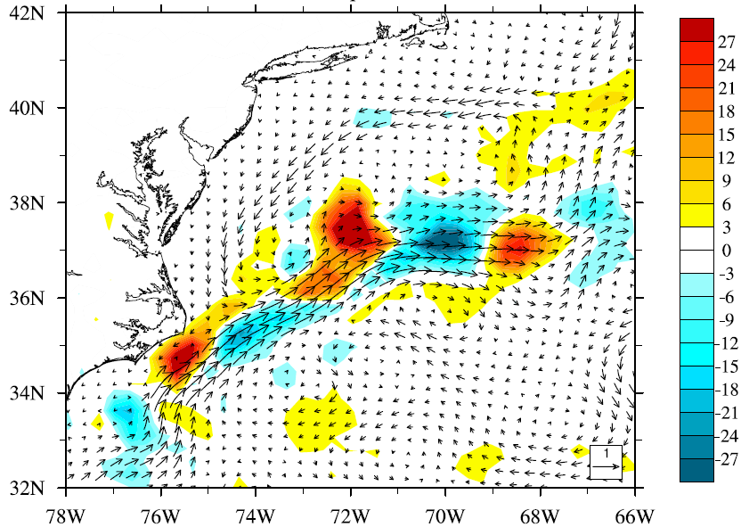
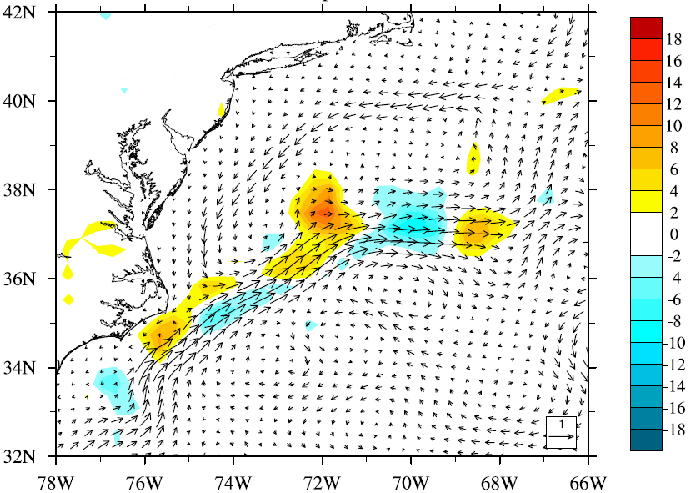
Heat fluxes response to SST change
(CUR- CTL)
Latent heat flux
W/m²
Sensible heat flux
W/m²
Change of heat fluxes is up to 10% near Gulf Stream when surface currents are allowed to modify the wind stress.

Slide 10
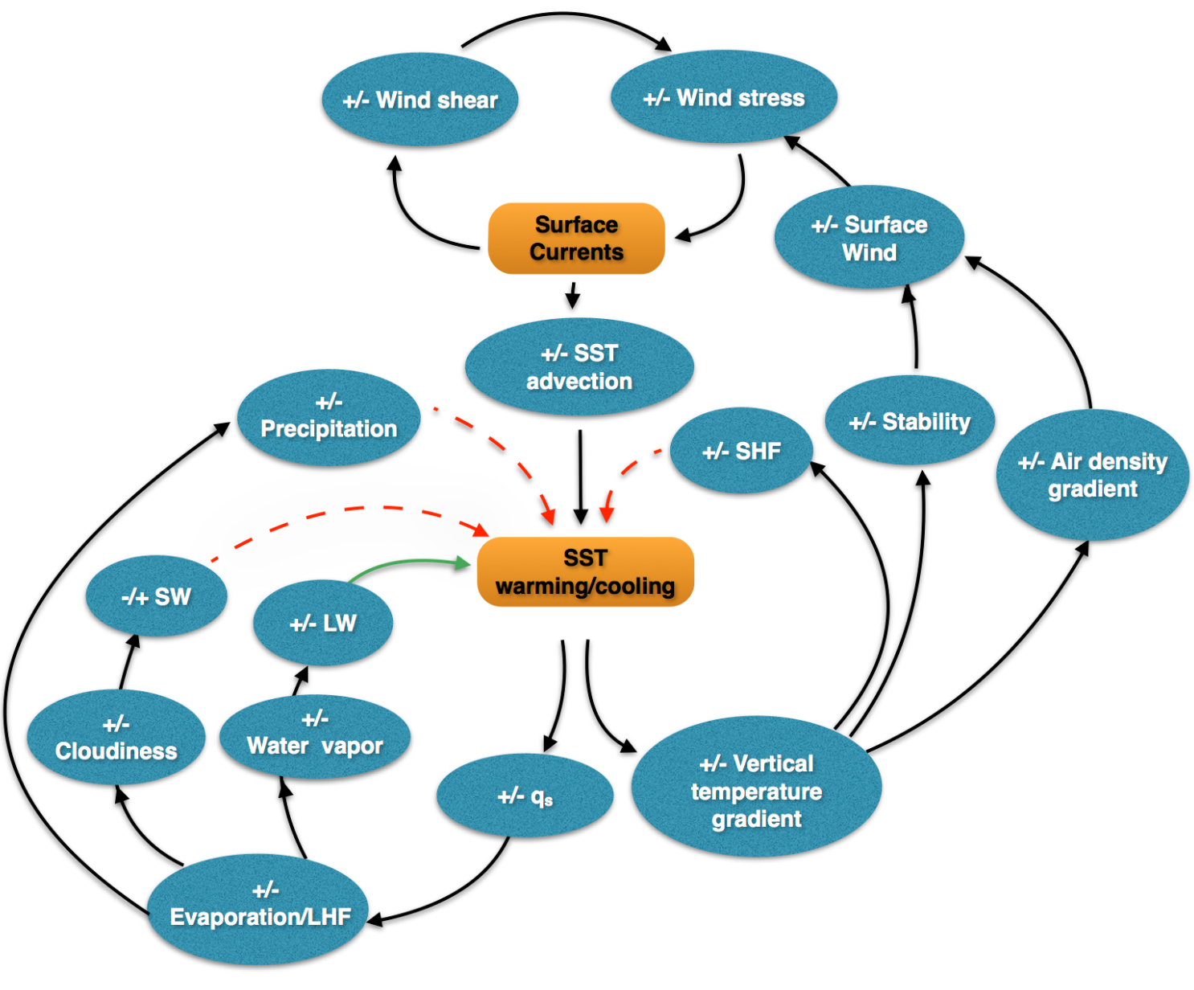
Coupling mechanisms
Positive feedback
Negative feedback
SST: Sea Surface Temperature qs: Saturation vapor pressure
LHF: Latent Heat Flux SHF: Sensible Heat Flux
SW: Short-Wave radiation LW: Long-Wave radiation

Slide 11
Broader Science and Applications
Key outstanding questions
  How are winds and surface currents coupled?
    Very important for understanding upper ocean mixing
      5 km resolution is sufficient to capture all but the smallest eddies
    Hence for energy and carbon budgets
    Large impact on vertical transport of nutrients, and hence important to biology and ecosystems
  How great is the equatorial upwelling, and what is the wind-induced variability? (impact cycles of energy, water and carbon)
  How do winds and currents move fresh water Arctic and Nordic Seas?
Applications:
  Debris transport, nutrient transport and primary productivity, iceberg transport and primary productivity, ice motion, seasonal to interseasonal forecasting, ocean forecasting and more

Slide 12
Requirements
Resolve mesoscale (atmosphere and ocean)
  5km grid space
For coupling with ocean features, which as slowly evolving compared to the atmosphere, currents can be sufficiently accurately resolved with 0.5 m/s accuracy in current speed
  assuming Gaussian random vector component errors
    which is a good assumption
  Assumes wide swath sampling (1600 km wide, 200km nadir gap)
Wind vector component accuracy of 0.8 m/s is sufficient for most applications, and is achieved with scatterometers

Slide 13
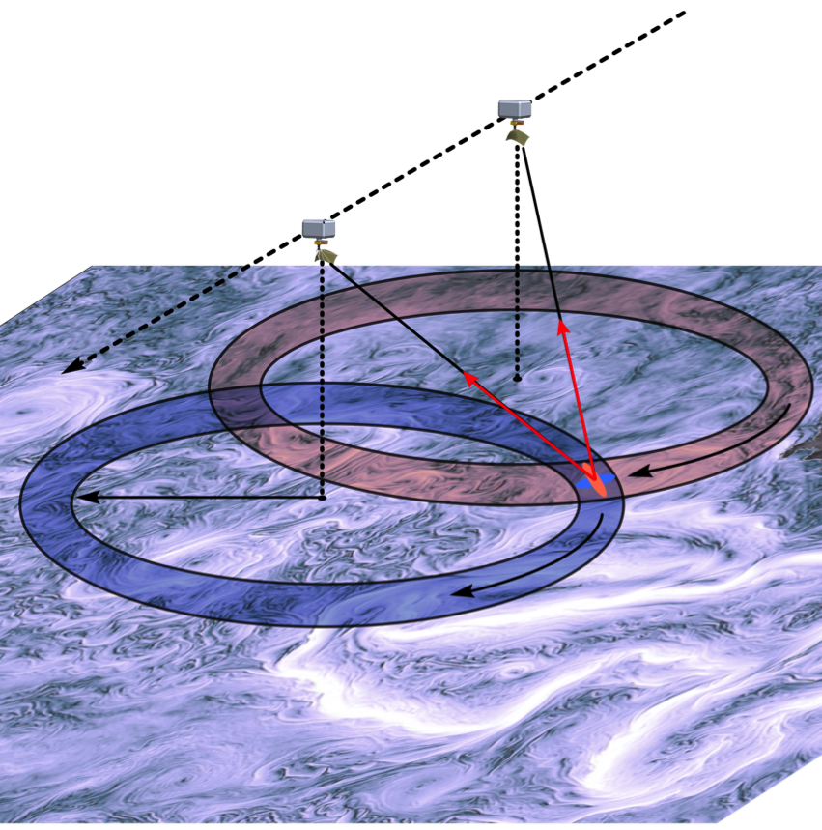
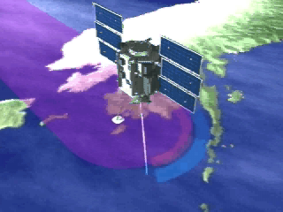
Winds and Currents Mission Measurement Concept
Ka-band rotating pencil beam Doppler scatterometer
Ku-band rotating beam scatterometer
Winds measured from Ka/Ku σ₀ measurements at multiple azimuth angles
  Heritage: QuikSCAT, RapidScat, OSCAT
Surface currents from Doppler measurements at multiple azimuth angles
  Heritage: SAR Doppler, Along-track interferometry
Temporal coverage achieved by a roughly 1600 km swath
700 km
800 km

Slide 14
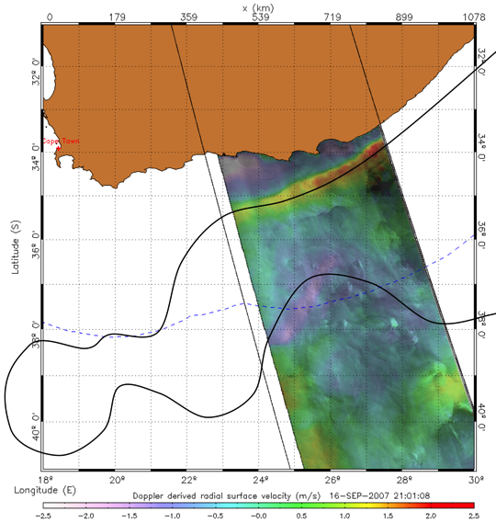
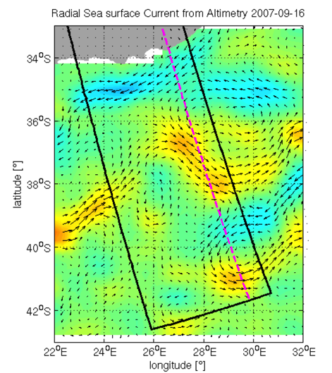
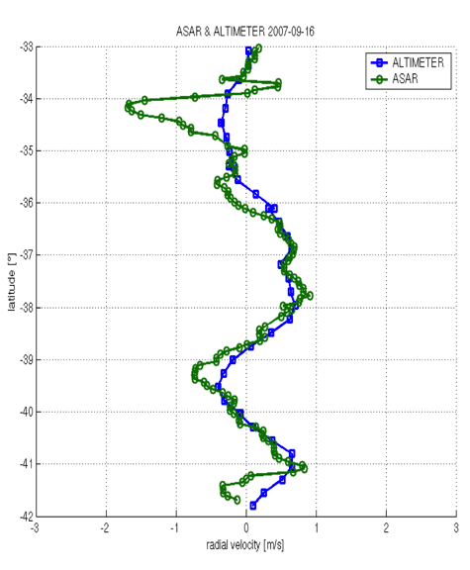

Currents Spaceborne Demonstration(ASAR)
Agulhas
main stream
Mesoscale
eddy
Radial
direction
Comparison of Doppler currents with altimeter radial velocity estimates along the SAR line of sight. Both capture an eddy, but only the high spatial Doppler resolution captures the narrow Agulhas main stream current.
Surface velocity measurements along the line of sight direction have been demonstrated multiple times from spaceborne SARs. Example from Agulhas current observed by ASAR at 10km resolution.
Nadir altimeters can observe one dimensional geostrophic currents. By combining multiple altimeters, 2D geostrophic currents can be estimated at ~200km resolution.

Slide 15
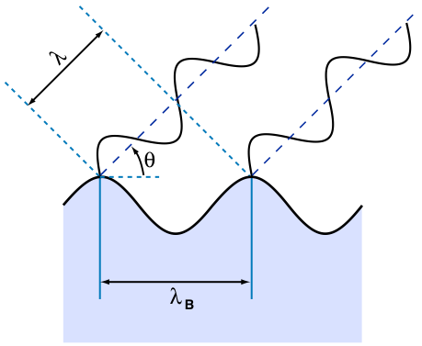
What is Scattering?
The dominant source of the radar return occurs when there is coherent addition of scattered energy (Bragg scattering)
Bragg scattering predicts that surface spectral components with wavenumbers k_{B}=2ksin(θ-α) will dominate the returns. (α is the surface slope)
The Bragg resonant wavelengths are given by λ_{B} = λ/2sin(θ−α)
It has been observed that scattering is due to independent patches of waves which satisfy the Bragg condition

Slide 16
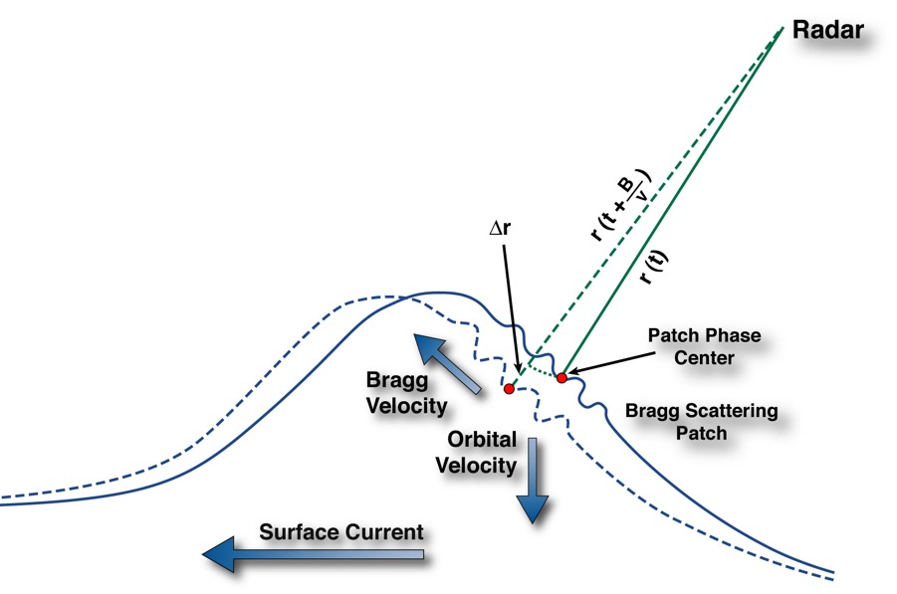
What Velocity are we Measuring?
Surface scatterers (resonant gravity/gravity-capillary waves satisfying the Bragg condition) motion is due to several effects:
phase velocity of resonant patch;
orbital wave velocity;
advection due to surface currents.
Additional platform motion and scattering effects can also appear.
Phase velocity of waves can be estimated using the dispersion relation and knowledge of the wind direction.
Orbital wave velocity component almost averages out after averaging over kilometer scales, leaving only the surface drift due to orbital motion: Stokes drift.
Residual motion is due to the surface current (including Stokes drift).

Slide 17
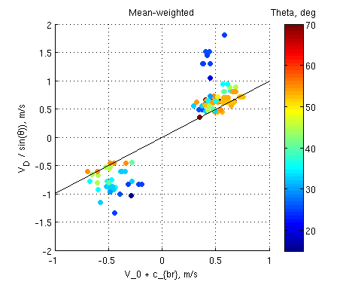
Doppler Currents- Experimental Basis
The measured Doppler velocity is the sum of the surface current velocity and the phase speed of Bragg resonant waves.
In order to remove Bragg contribution, it is necessary to:
  Measure the Doppler from different azimuth directions
  Know the wind direction (from scatterometer) to infer net direction of wave propagation for Bragg scattering waves
Doppler Current Component (m/s)
Incidence Angle (degrees)
Observed Current Component (m/s)
Experimental observations between Doppler radial current and the sum of the true current and the Bragg phase speed. (Yurovsky et al.)
The Bragg speed can be removed when it lies along the line, which is true for incidence angles above ~50º at Ka-band.

Slide 18
Summary
The Waves and Currents Mission could be developed to greatly improve our understanding or air/sea coupling
  As we move toward earth system models, with coupled ocean, air and ice, this knowledge will be critical to move forward with these models
  There are a huge number of applications that also benefit from these observations
There is excellent space-based heritage and recent testing on which to base such a mission
A Ka-band Doppler scatterometer can do this as shown, and could be scaled up to do it better

Slide 19
WINDS AND CURRENTS MISSION
Mark A. Bourassa and Qi Shi
With much of the modeled coupling shown here from Qi Shi
And a great deal of input from the Winds and Currents team:
Ernesto Rodriguez, Dudley Chelton, Dmitry Dukhovskoy,
Tom Farrar, M. Mar Flexas, Brian Haus, David Long, Rick Lumpkin, Thomas Kilpatrick, Nikolai Maxeminko, Dimitris Menemenlis, Steven L. Morey, Alexis Mouche, Dragana Perkovich,
Roger Samelson, Bryan Styles, Andrew Thompson,
Frank Wentz, and Shang-Ping Xie
& the rest of the WaCM team

Slide 20
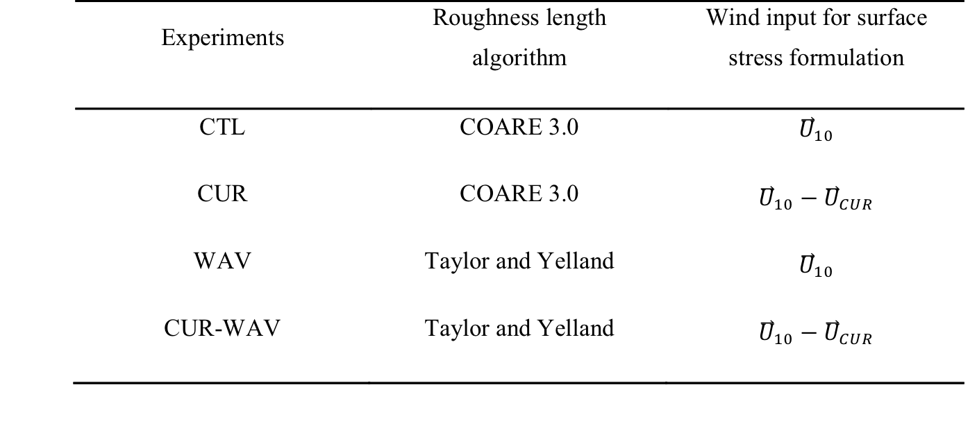
Experimental design
These experiments were designed to separate the ocean currents’ effect on the wind stress from the wave effect. The four experiments differ only in how wind stress is calculated in the bulk parameterization equation.

Slide 21
Bragg Wavelength Dependency on Wave Slope
Bragg wavelength for Ka-band is ~0.8 cm
The dominant contributors to the radar scattering mechanism for WaCM will be capillary waves (technically ultra-gravity waves) at wavelengths of approximately 0.5cm.
This wavelength is weakly dependent on incidence angles for incidence angles above 45º.

Slide 22
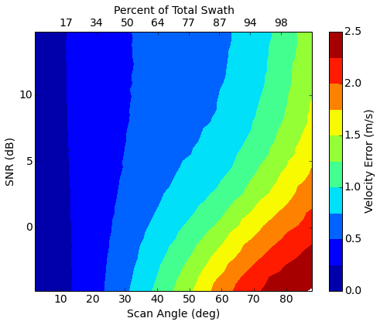
Winds and Currents Mission
Expected Radial Velocity Error (for currents)
Measurement requirement is for 0.5 m/s velocity random component error for footprints of 5km x 5km
Estimates of radial velocity error shows that this can be achieved as long as signal to noise ratio is high enough
  Current error budget for winds > 5m/s
  Performance degradation is graceful with SNR
1.8
1.2
7 m/s Wind CBE SNR
0.9
0.6
0.3
Radial velocity error for a 5km x 5km radar footprint. Greyed-out area is not used for current retrieval (20% swath reduction, still achieves temporal coverage)

Slide 23
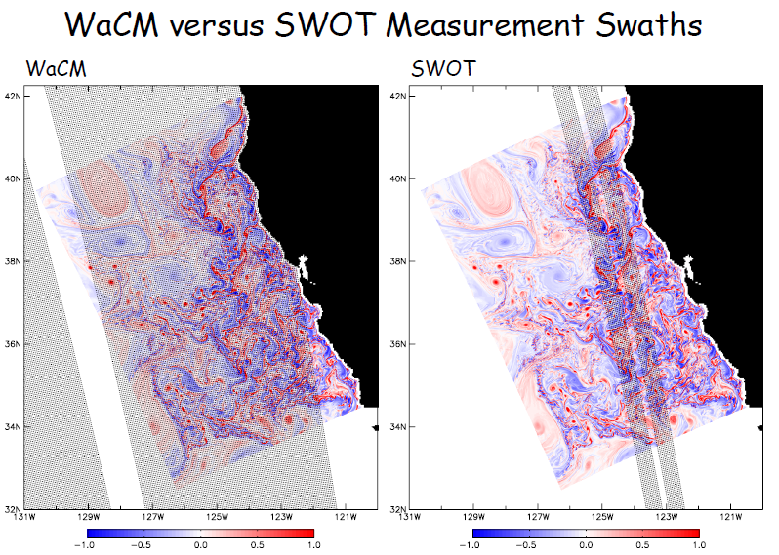
Differences With Respect to SWOT
Actual surface current rather than a geostrophic current (a surface current inferred from incorrect physical assumptions)
Vector winds (stress)
Noisier currents for single overpass
Much better sampling
Combining to result in more accurate currents.

