Slide 1
Arizona
Nancy J. Selover, Ph.D.
State Climatologist
School of Geographical Sciences & Urban Planning
Senior Sustainability Scientist, Global Institute of Sustainability
Arizona State University
selover@asu.edu
http://azclimate.asu.edu/
AASC 37th Annual Meeting July 9-12, 2012
Destin, FL

Slide 2
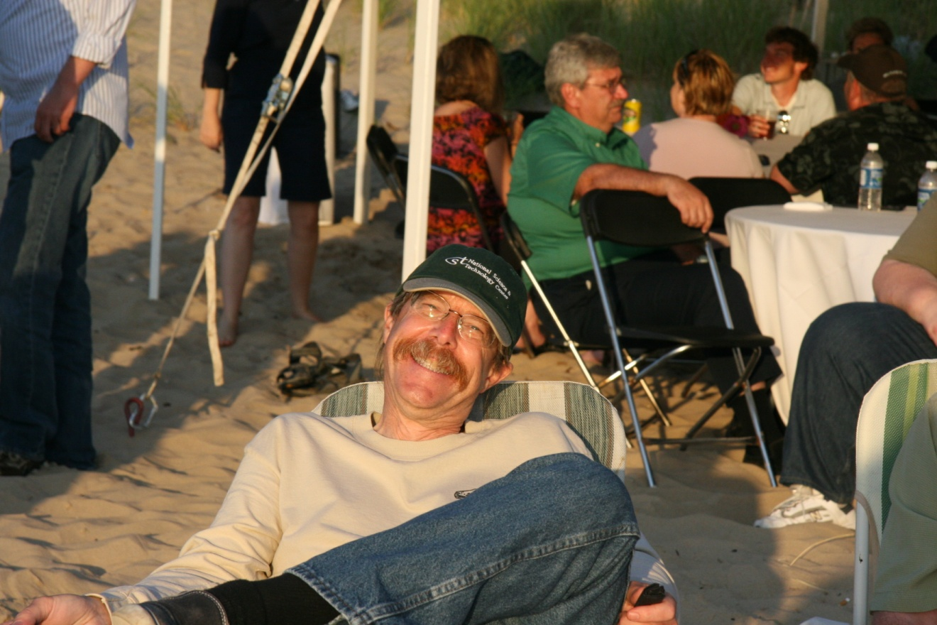
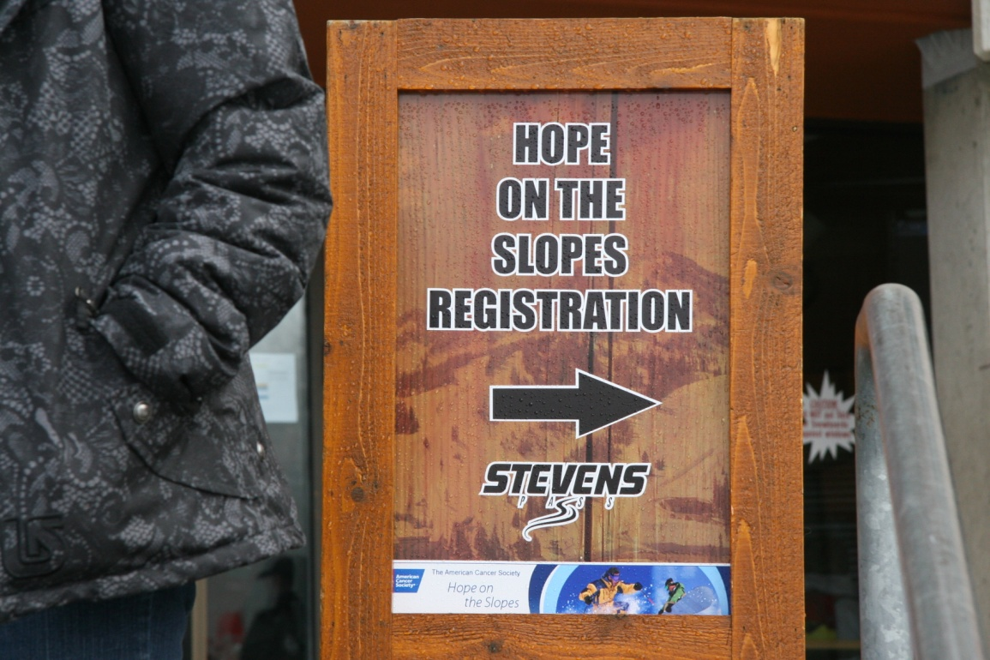
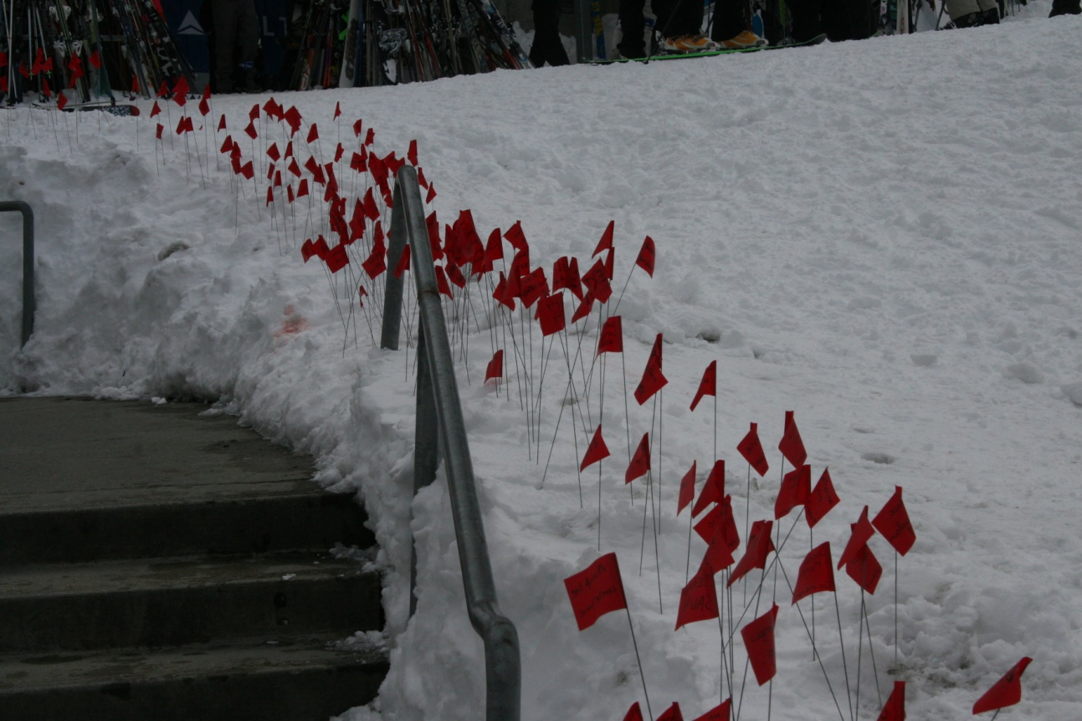
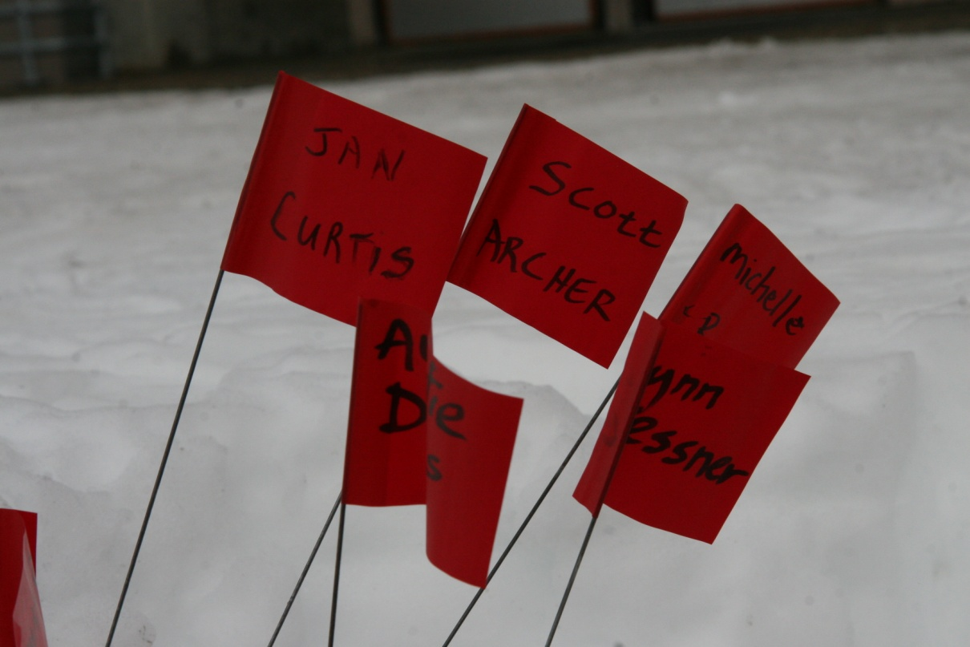
Hope on the Slopes
We raised over $1600 for Scott Archer and Jan Curtis

Slide 3
GIS Skills in Climatology
Updating geodatabases
Preparing maps (drought) – automating maps with python scripting
Working with GIS applications
GIS visualizations and animations for decision making tools – e.g. sea level rise
Authoring and deploying fast web maps
Publishing Optimized Map Services – (NOAA Coastal Services)
SQL server queries
Generating kml/kmz files for importing into GoogleEarth
Exportable shapefiles.
Spatial Analyses using multiple layers and buffers, including DEMs, Geology, land cover, hydrology, etc.
Calculating spatial indices, Palmer, MBDI, SPI, drought, etc.
Interpolation – which method is best for which variable.
Combining surface, radar, satellite, aerial photos, and other spatial data for decision making – i.e. evacuation routes, storm damage, etc.
Most important is the background discipline – meteorology, climatology, hydrology, etc.

Slide 4
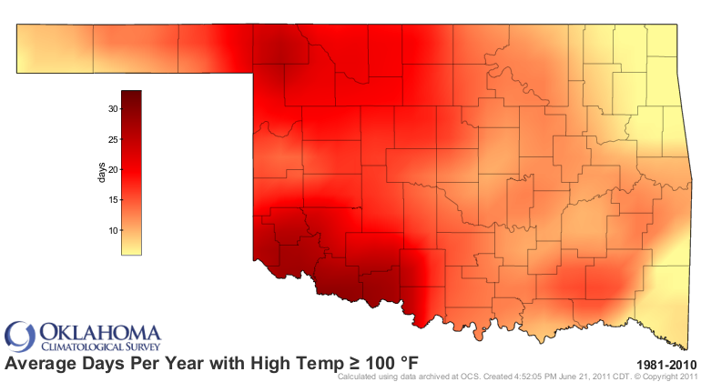

Slide 5
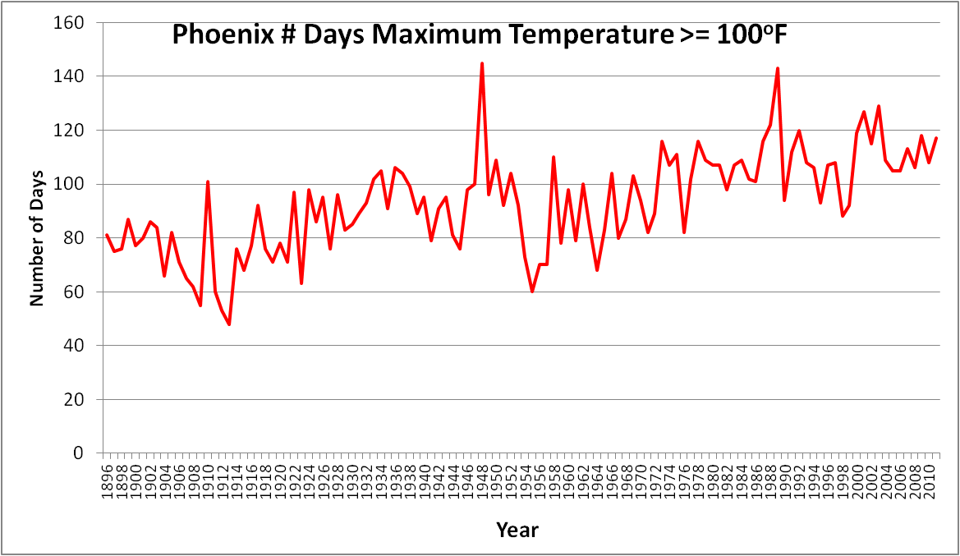

Slide 6
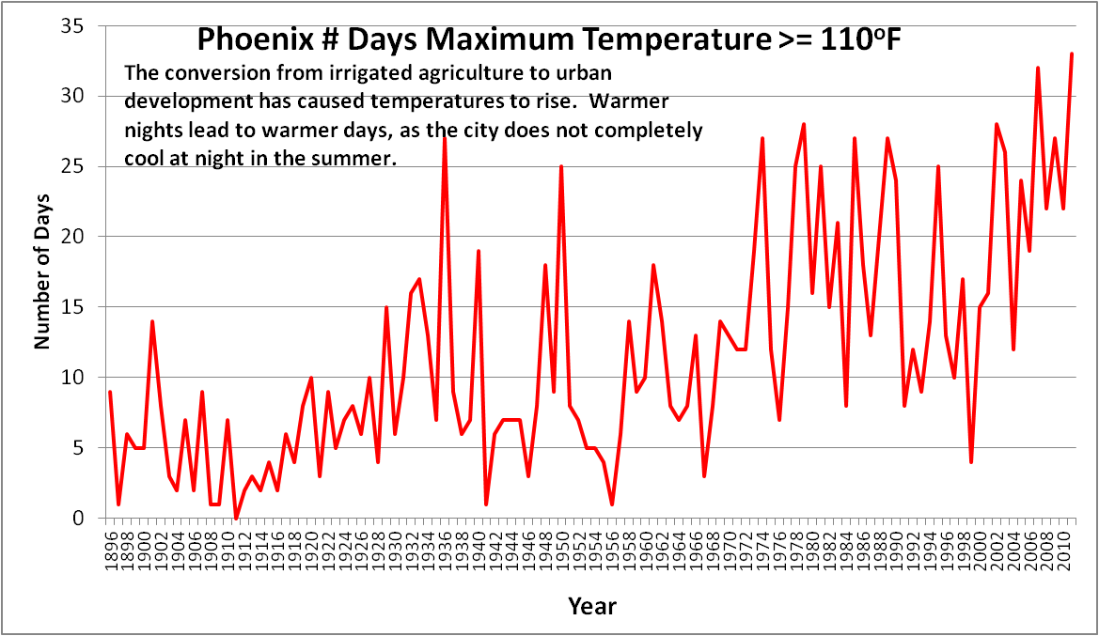
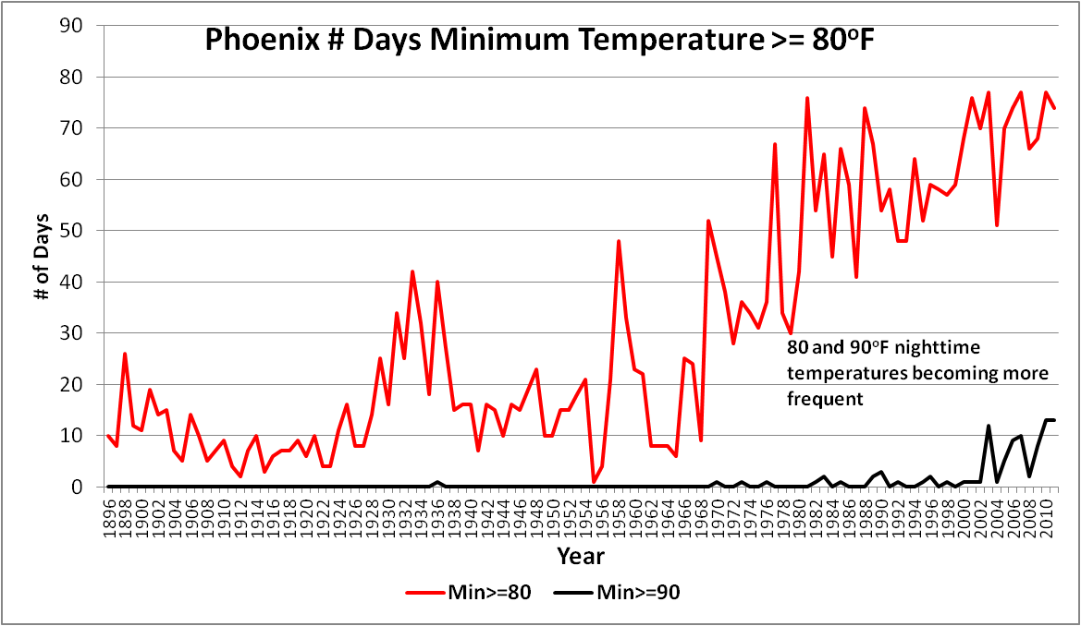

Slide 7
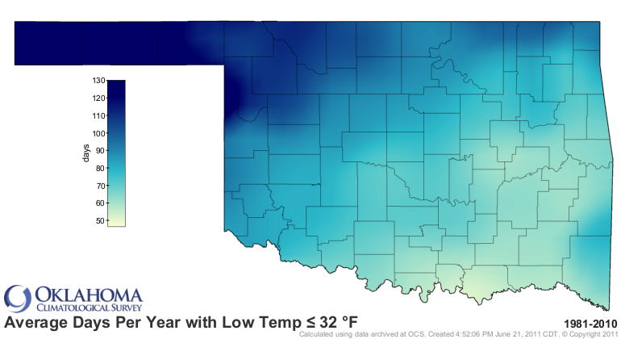

Slide 8
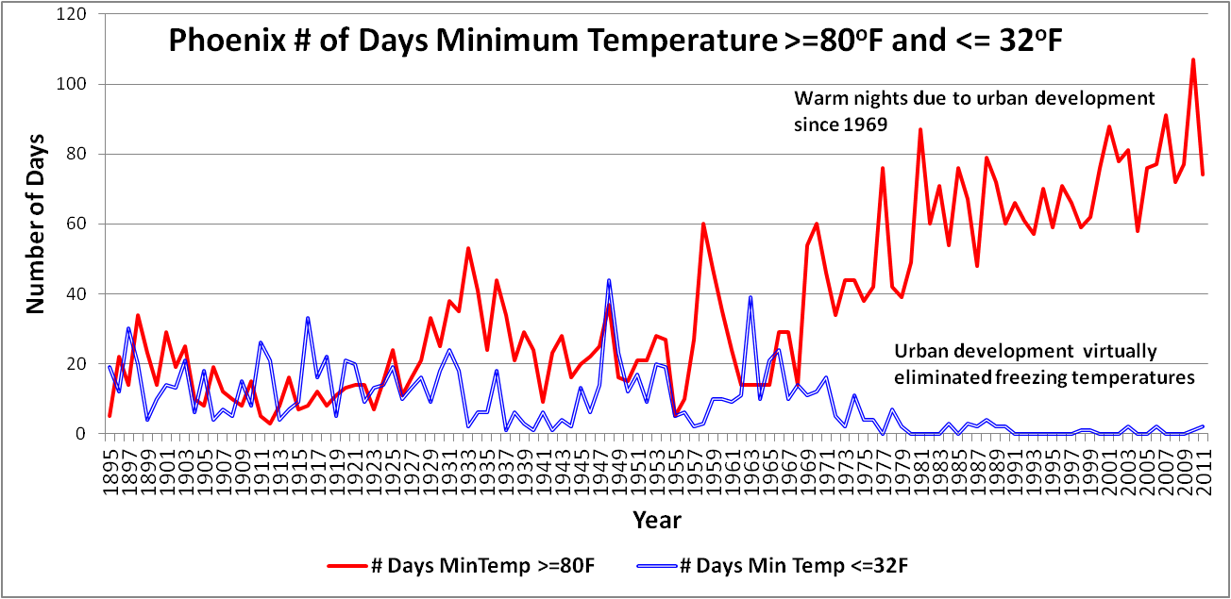

Slide 9
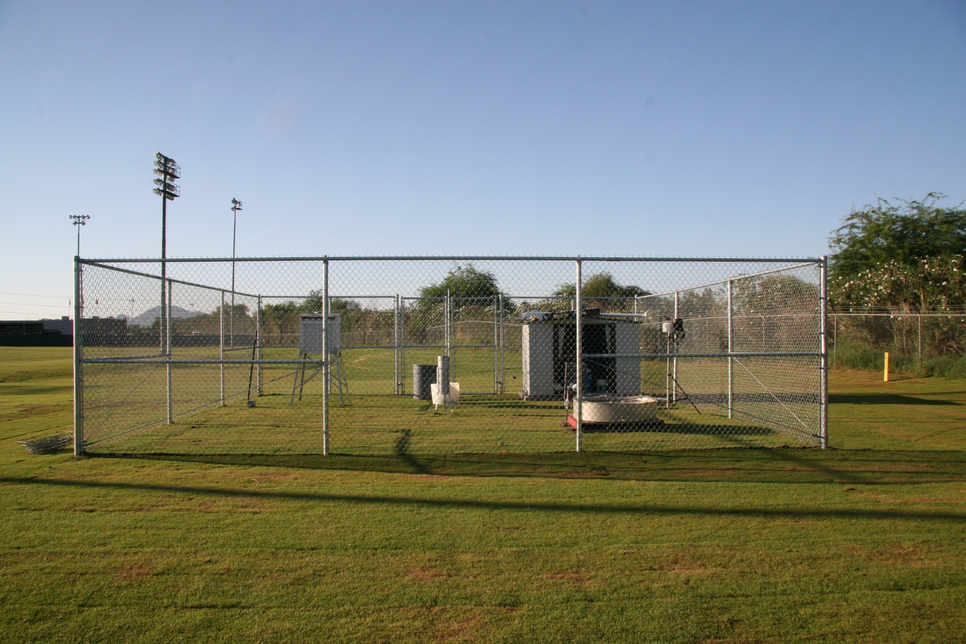
Tempe COOP Evaporation Pan – Ref ET

Slide 10
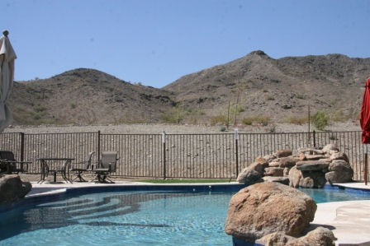

Slide 11
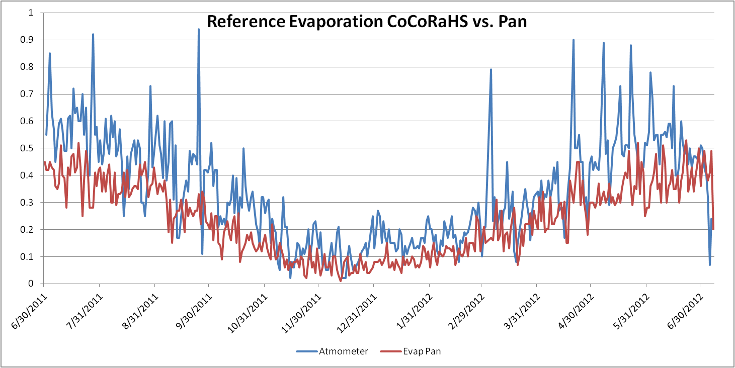

Slide 12
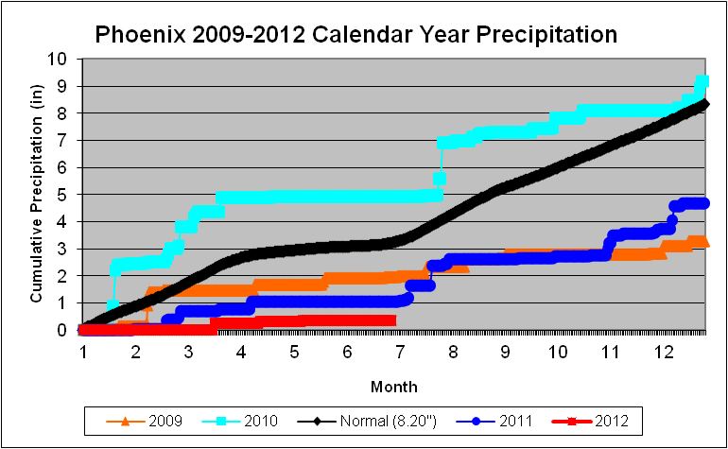
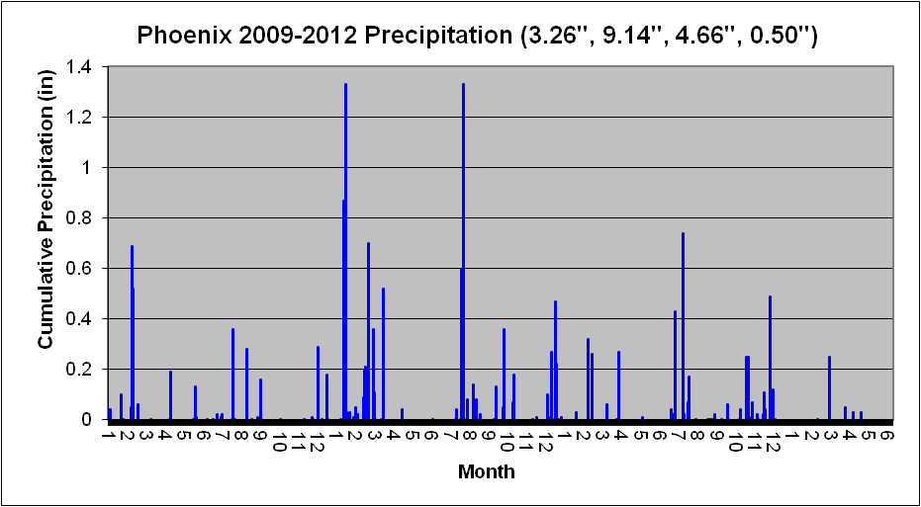
Rain Days
2009 – 22 3.26”
2010 – 38 9.14”
2011 – 33 4.66”
2012 - 5 0.50”

Slide 13
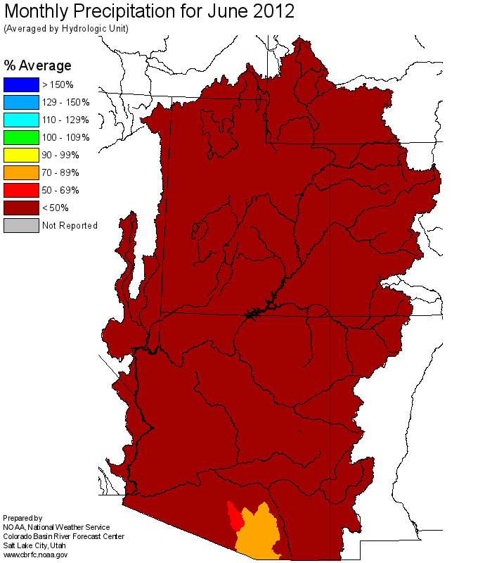

Slide 14
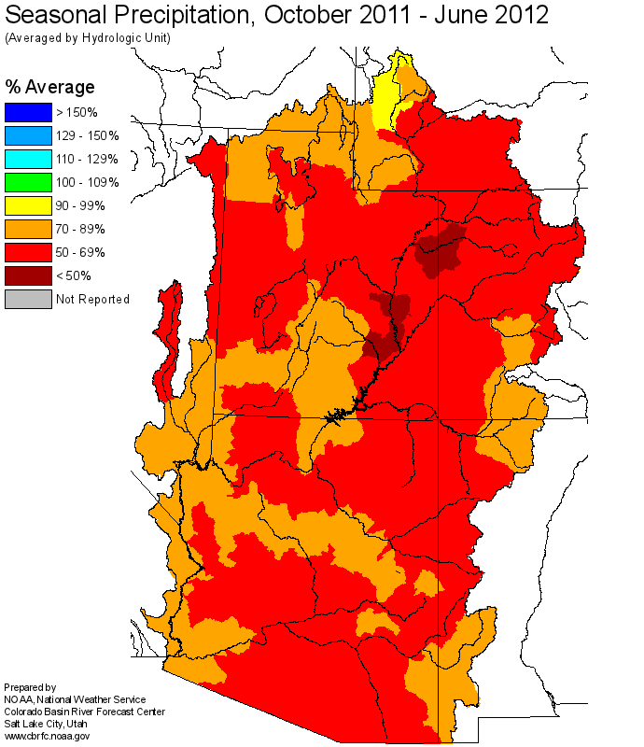

Slide 15
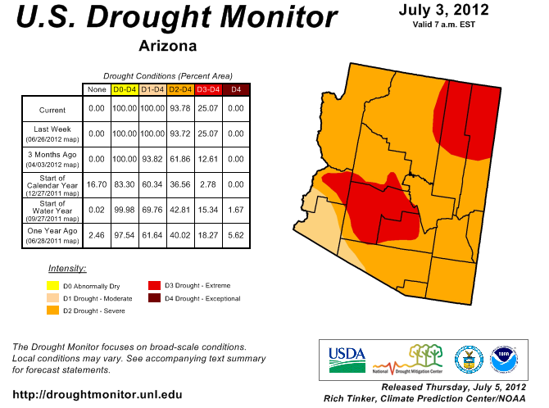

Slide 16
Is Arizona the new COOL place??
New High Maximum Temperature Records set in 2012:
18 in April
New High Minimum Temperature Records set in 2012:
3 in April
2 in May

Slide 17
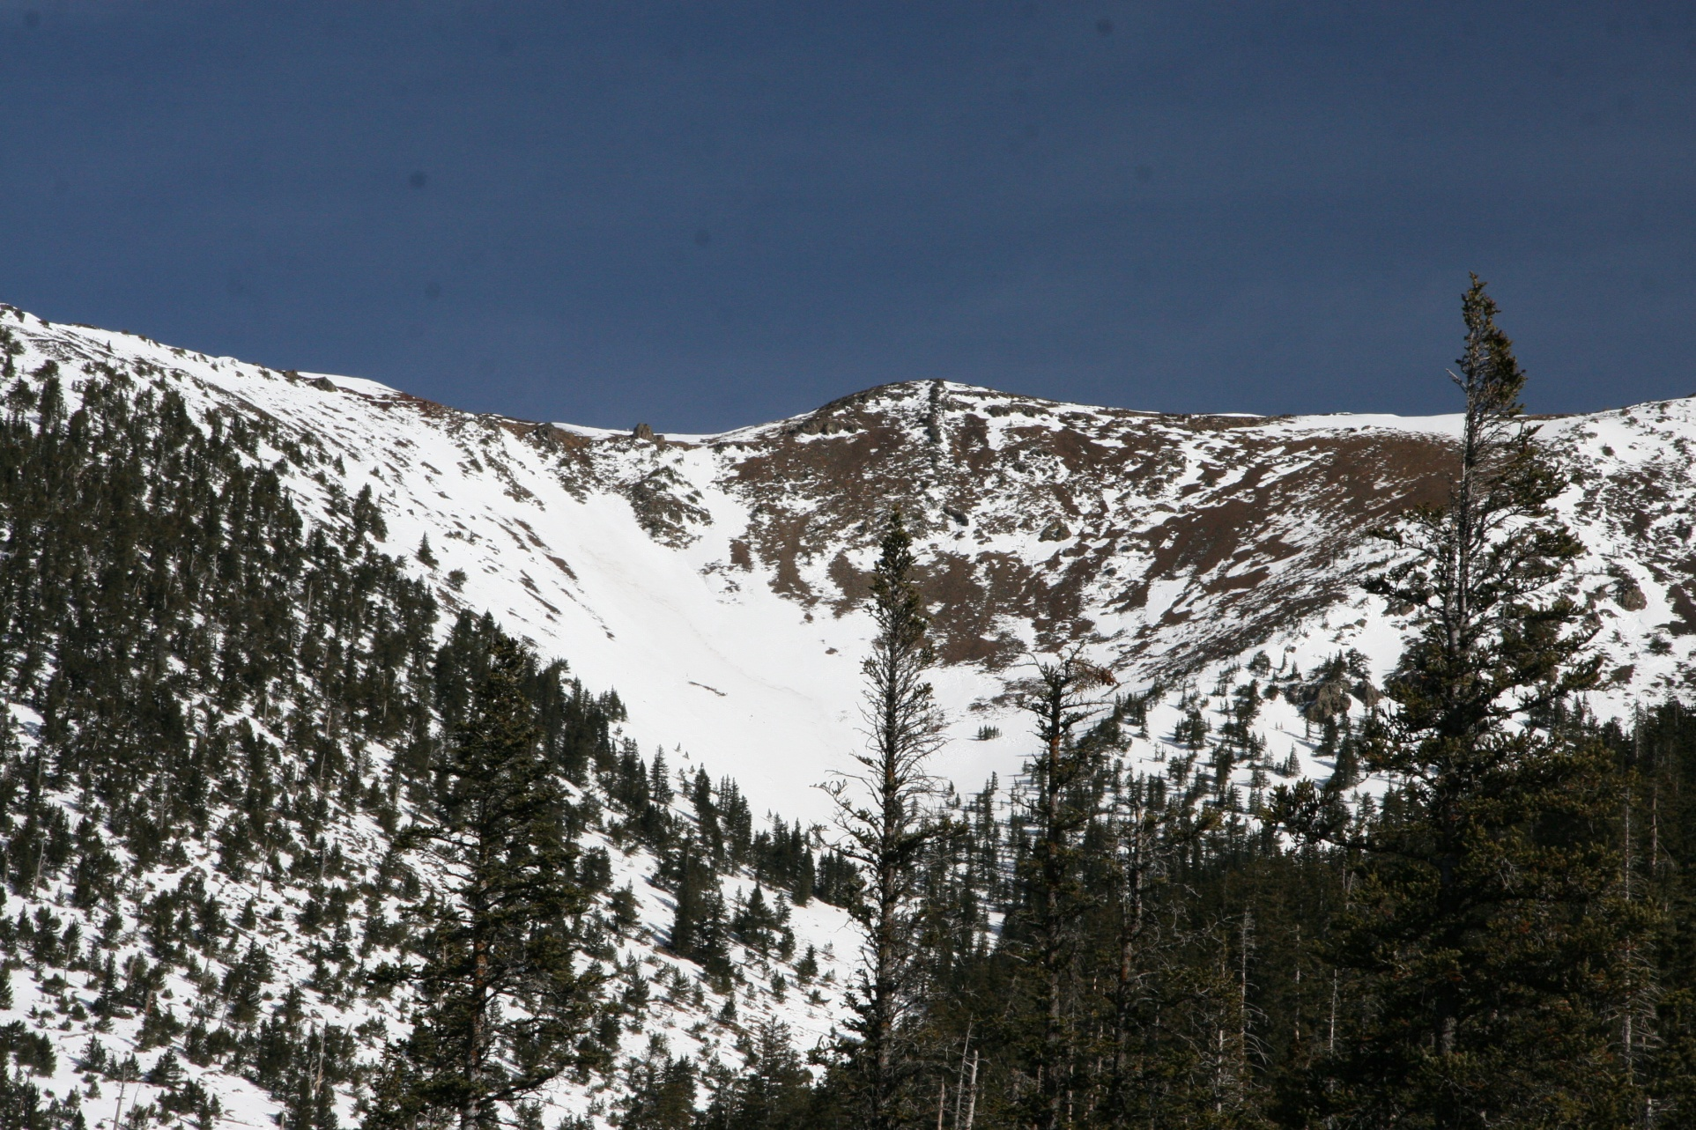
Arizona Snowbowl – Flagstaff Dec 29, 2011

Slide 18
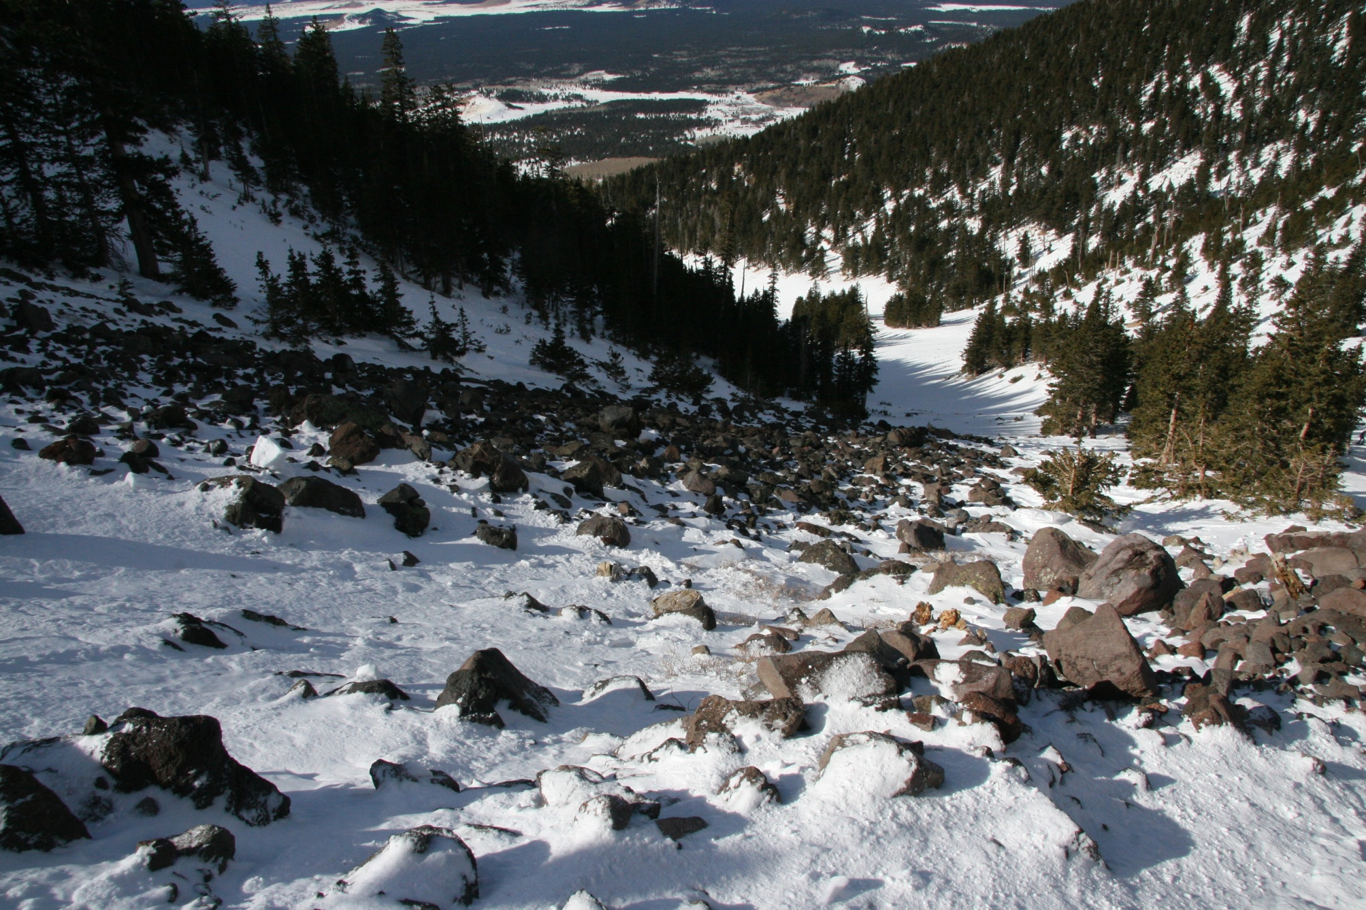
Arizona Snowbowl – Flagstaff Dec 29, 2011

Slide 19
Climate Change has come to the Phoenix Metropolitan area – not as a result of “Global Warming”, but as a result of the urban heat island and nearly 2 decades of drought.

Slide 20
Climate Change has come to the Phoenix Metropolitan area – not as a result of “Global Warming”, but as a result of the urban heat island and nearly 2 decades of drought.
The effects of the increased heat on our energy and water resources are significant and require adaptation as well as mitigation.

Slide 21
Climate Change has come to the Phoenix Metropolitan area – not as a result of “Global Warming”, but as a result of the urban heat island and nearly 2 decades of drought.
The effects of the increased heat on our energy and water resources are significant and require adaptation as well as mitigation.
This has prompted the 23 cities and tribes in the Phoenix Metro area to call on the University for help in the way of Climate Services.

Slide 22
Climate Change has come to the Phoenix Metropolitan area – not as a result of “Global Warming”, but as a result of the urban heat island and nearly 2 decades of drought.
The effects of the increased heat on our energy and water resources are significant and require adaptation as well as mitigation.
This has prompted the 23 cities and tribes in the Phoenix Metro area to call on the University for help in the way of Climate Services.
Arizona State University has responded by establishing the Center for Integrated Solutions to Climate Challenges (the Climate Center at ASU) focussing on urban centers in arid regions, starting with Phoenix.

Slide 23
Climate Change has come to the Phoenix Metropolitan area – not as a result of “Global Warming”, but as a result of the urban heat island and nearly 2 decades of drought.
The effects of the increased heat on our energy and water resources are significant and require adaptation as well as mitigation.
This has prompted the 23 cities and tribes in the Phoenix Metro area to call on the University for help in the way of Climate Services.
Arizona State University has responded by establishing the Center for Integrated Solutions to Climate Challenges (the Climate Center at ASU) focussing on urban centers in arid regions, starting with Phoenix.
At the center of the Climate Center is the State Climate Office. The core of the operation is making the research accessible and useful to the decision-makers. The Center is part of the School of Sustainability.

