Slide 1
State Report:
North Carolina
Ryan Boyles
37th Annual Meeting
American Association of State Climatologists
July 11, 2012

Slide 2
Highlights: Extension
Weekly drought calls
New web layout to integrate all tools around themes
New tools + training videos
Ag and crop disease
Fire weather – NFDRS on ECONet
Reservoir inflow forecasts
PINEMAP – climate impacts to production forestry
Renewed focus on science translation and delivery

Slide 3
Highlights: Research
Soil moisture modeling
High resolution model re-analysis
Localized Climate Extremes Index
Downscaling- geospatial wx generator
Climate Projections using historical station analogs

Slide 4
Above Normal
0
Normal
Below Normal
The LCEI includes
temperature, precipitation, drought (like NCDC CEI)
severe weather
winter weather
tropical activity
The LCEI:
Is flexibly crafted for each states (the weights can be tailored to each state)
has been evaluated for NC and FL
Has a poster here at AASC! Come by and learn more!

Slide 5
Highlights: Outreach
Large group outreach events w/ state natural science museum
4 middle school interns
Climate education for professional development
Twitter

Slide 6
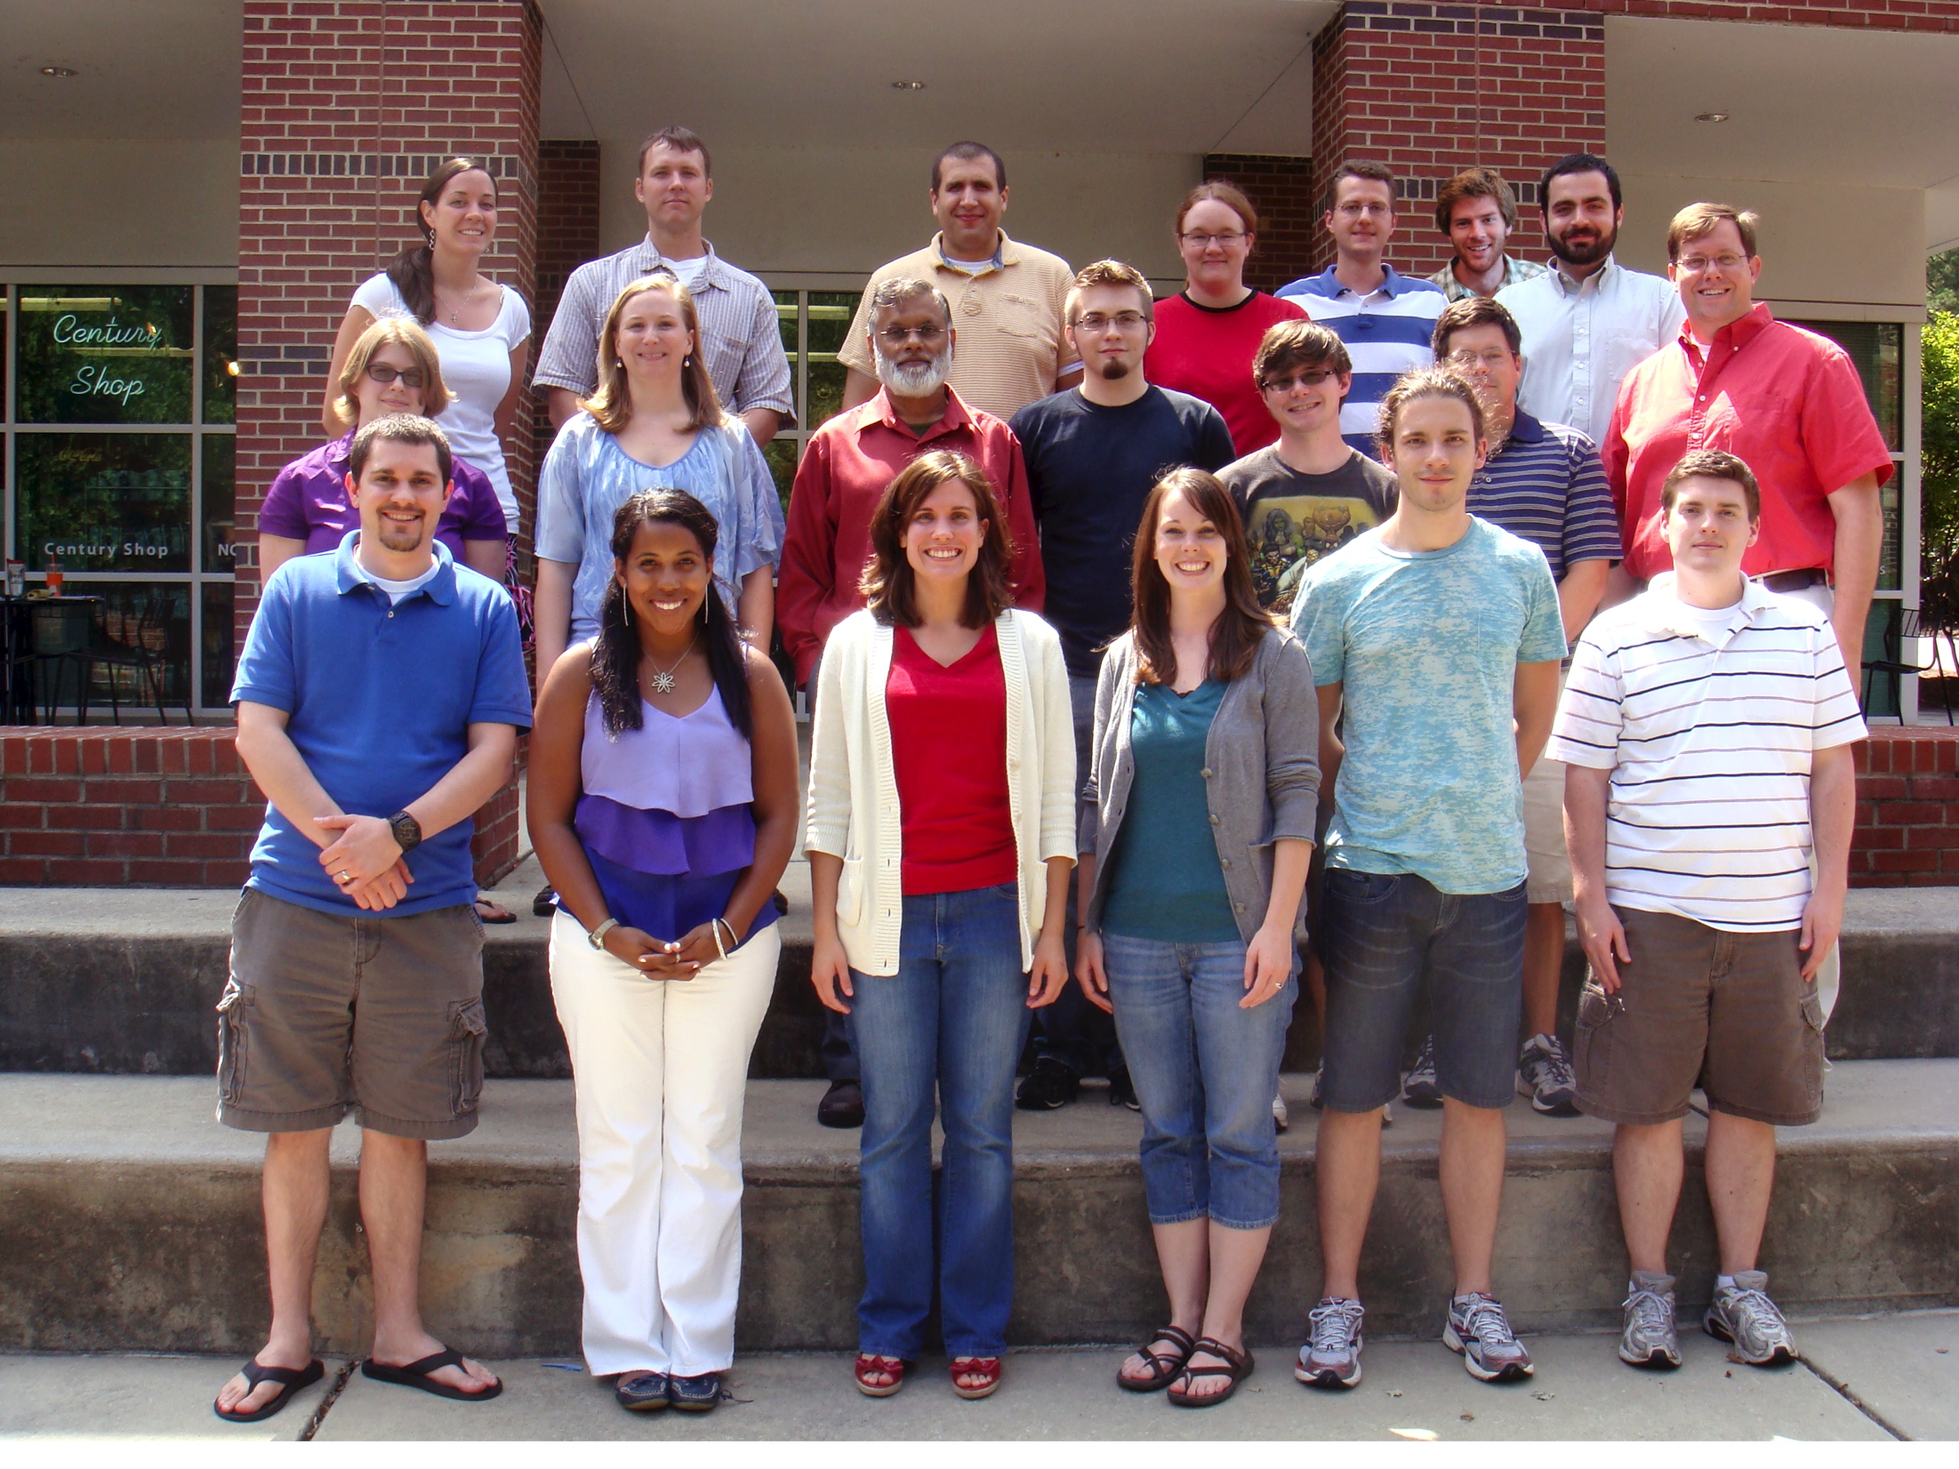

Slide 7
Toward routine radar-based SPI
John Nielsen-Gammon, Brent McRoberts (TAMU)
Dev Niyogi (Purdue)
Rebecca Cumbie, John McGuire, Ryan Boyles (NCSU)

Slide 8
What is it?
~5km SPI using methods from TAMU
Gauge calibrated radar (MPE)
See McRoberts & N-G JAMC 2011
Historical COOP data used to adjust MPE probability density function
COOP data spatially clustered using L-moments (see Hosking and Wallis)
Adjusted PDF used to generate SPI

Slide 9
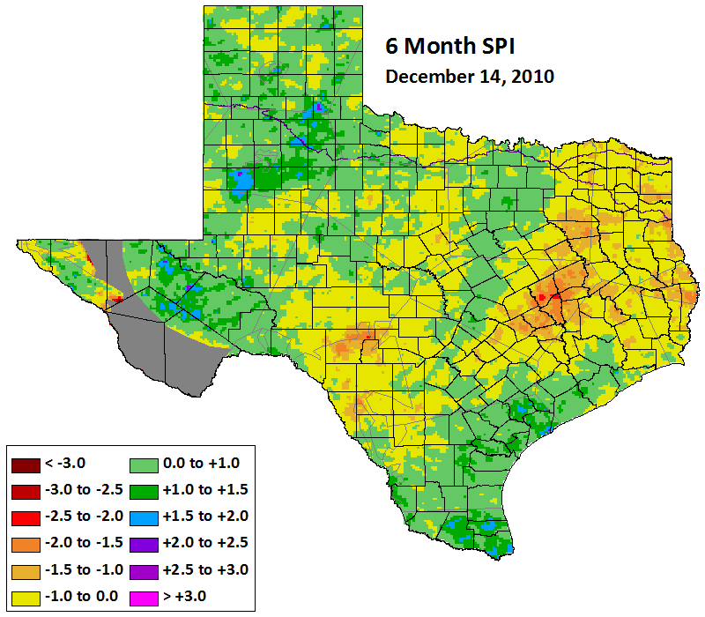
INSERT TAMU IMAGE

Slide 10
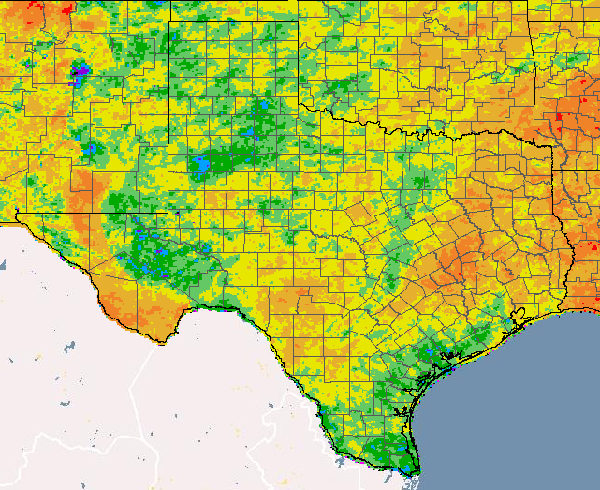
INSERT OUR TX

Slide 11
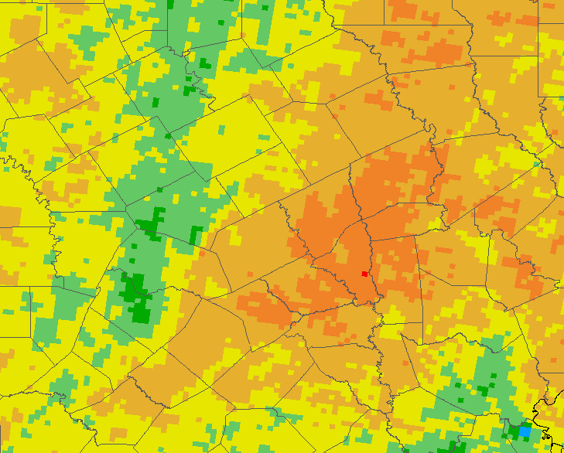
JNGs House

Slide 12
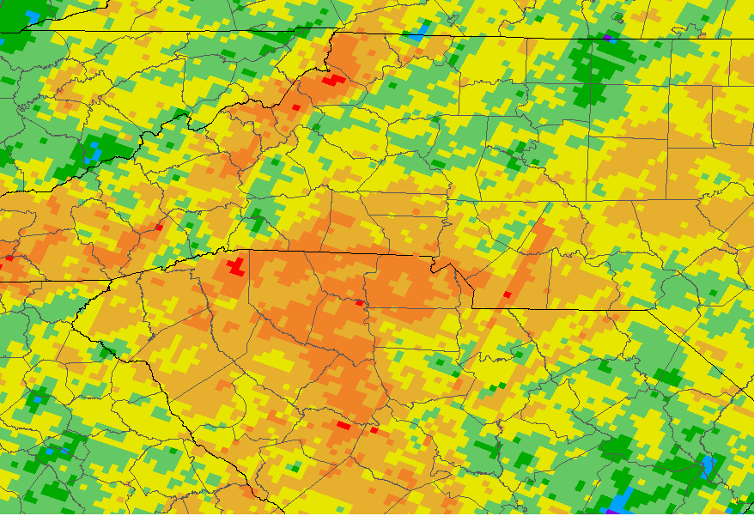
INSERT NC

Slide 13
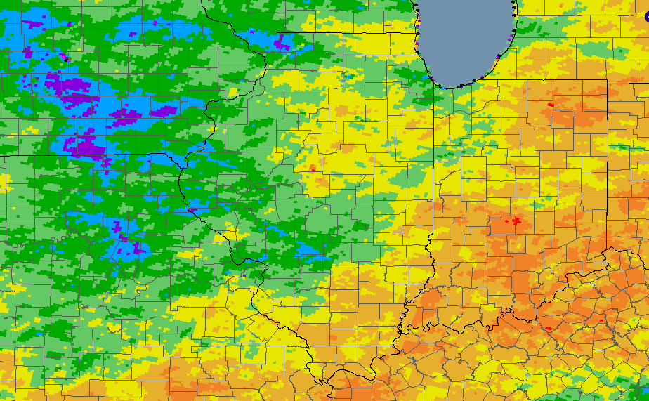
INSERT INDIANA

Slide 14
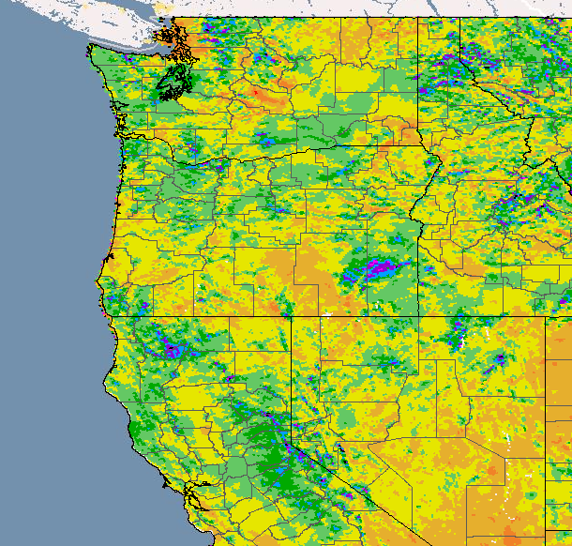

Slide 15
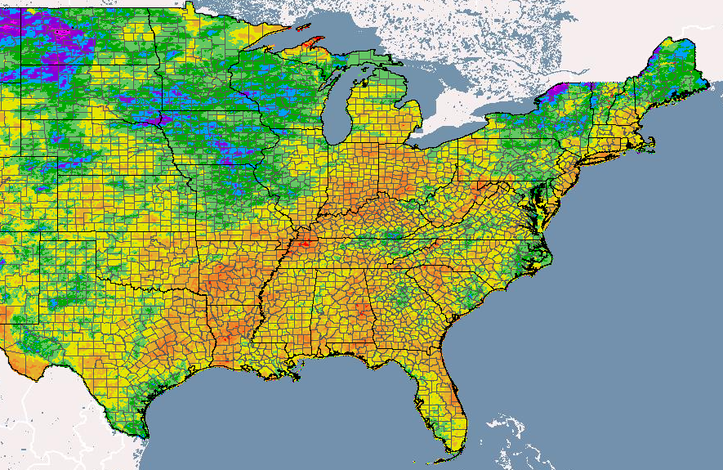
INSERT NATIONAL

Slide 16
What’s coming?
Work out remaining bugs
Send out for review and feedback
Connect local SPI to field impacts
What SPI best matches crop health
Web services for all
Tools that can sit on your web page
THREDDS server
Feed to drought.gov and NIDIS

Slide 17
Later…
Palmer, KBDI estimates using MPE
Grid-based SPI time series
Possible connections to seasonal forecasts
Probability of reaching critical SPI thresholds
Possible proposal to USDA to evaluate drought triggers
What’s the best drought indicator for crops in your state
AASC wide proposal?

