Slide 1
Overview of the SECC:
Integration, Leveraging , Complementarity
Keith Ingram, University of Florida
Presented to Review of SECC-RMA Partnership, Risk Reduction for Specialty Crops in the SE USA
Gainesville, FL 28-29 Jan 2009

Slide 2

Integrated Approaches
Across a multi-state region
Across disciplines
Across research, extension, and education

Slide 3
SECC Strategic Programs
Climate science
Agricultural research
Water resources management
Decision analysis
Agricultural extension

Slide 4
Traditional Land-grant Model for Technology Development & Dissemination
Research Faculty
Extension Faculty
County Extension
Farmers

Slide 5
Climate Information Development and Delivery System
Research Faculty
Climate Agriculture
Water Resources Decision Analysis
Extension Faculty
Climate Extension Specialists
Prototype AgClimate
Prototype CoastalClimate
Prototype SEWaterClimate
Agricultural & Forest Commodity Specialists
Information Delivery
State Climatologists
Cooperative Extension Services
AgroClimate
Extension Agents
Decision Makers
Agricultural producers, Green industry managers, Forest managers, Water resource managers, Policy makers

Slide 6
SECC Members
University of Florida: Crop modeling, extension, hydrology
Florida State University: Climate modeling, state climatologist
University of Georgia: Crop modeling, extension, hydrology, state climatologist, assessment
University of Miami: Assessment and evaluation, economics
University of Alabama – Huntsville: Climate and water, state climatologist
Auburn University: Agricultural and resource economics, hydrology
North Carolina State University: Pest modeling, state and regional climatologists

Slide 7
Unique features of the SECC
Strong emphasis on agricultural risk management
Diverse funding sources:
  NOAA RISA program ≈ 15 to 20%
  USDA RMA ≈ 10 to 20%
  USDA CSREES ≈ 50 to 60%
  Various competitive grants ≈ 15 to 30%
Strong administrative support:
  No overhead on “pass through” funds
  Regular meetings of researchers and administrators from member institutions

Slide 8
Putting the Pieces Together
Each funding source has a different emphasis:
  NOAA = Applications and assessment
  USDA CSREES = Fundamental research to provide the basis for developing practical tools
  USDA RMA = Risk management tools for agriculture
The ultimate focus of all SECC projects is decision support

Slide 9
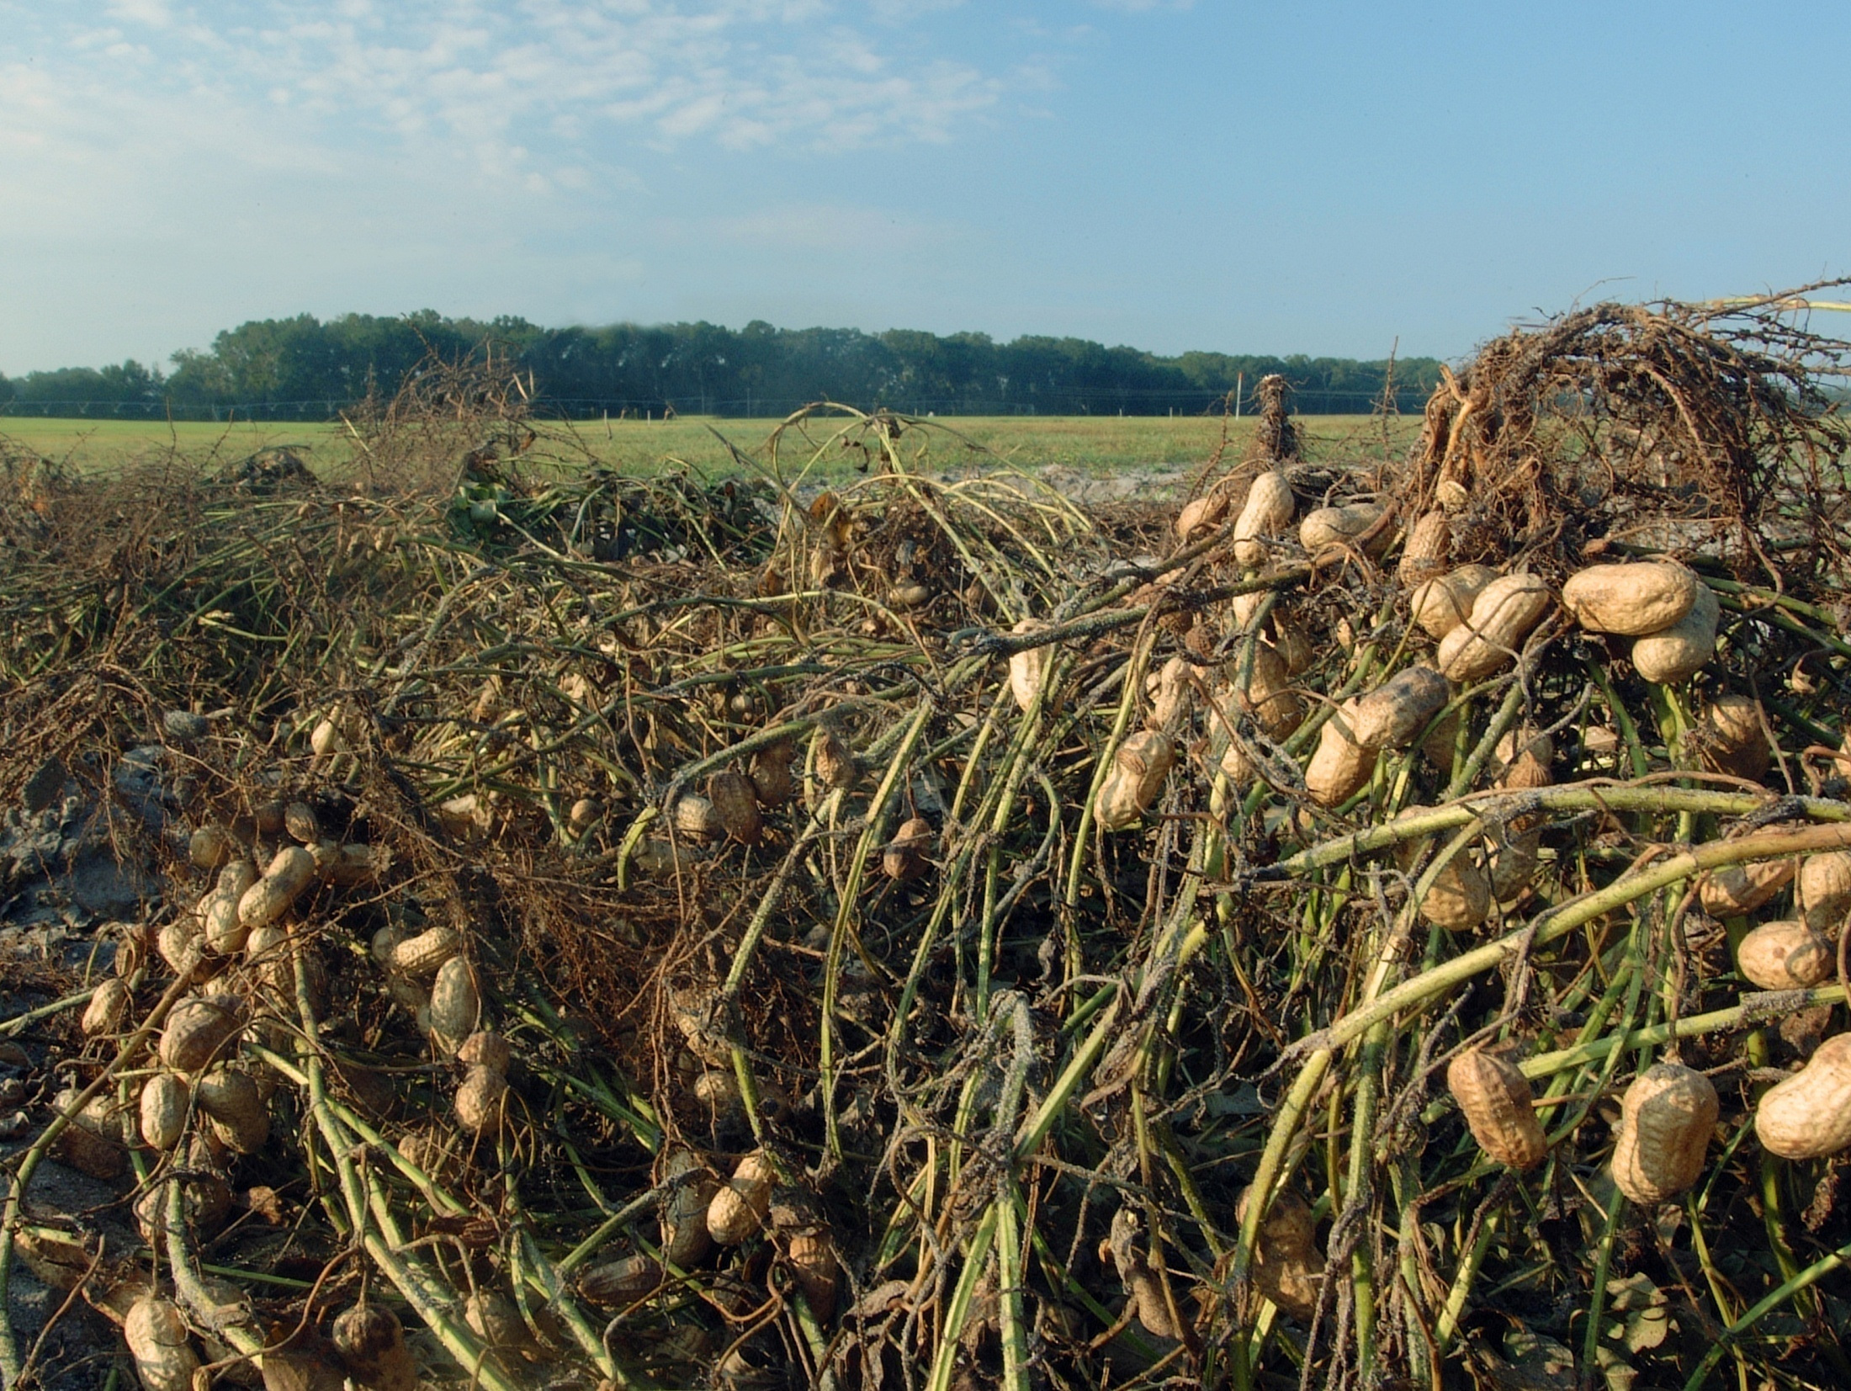
Please visit us at: AgroClimate.org and SEClimate.org

